Slide 1



Newtonian noise cancellation system for AdV+
Soumen Koley, Jan Harms et al.

Slide 2
Contents
Newtonian noise – Fundamentals
NNC array layout
Seismic noise amplitude characteristics
Temporal variation
Spatial variation
Wavefield decomposition
Interstation cross-correlation
Cross-correlation reconstruction
Wiener Filter
Theory
Implementation
Performance
Adaptive Filters
Performance

Slide 3
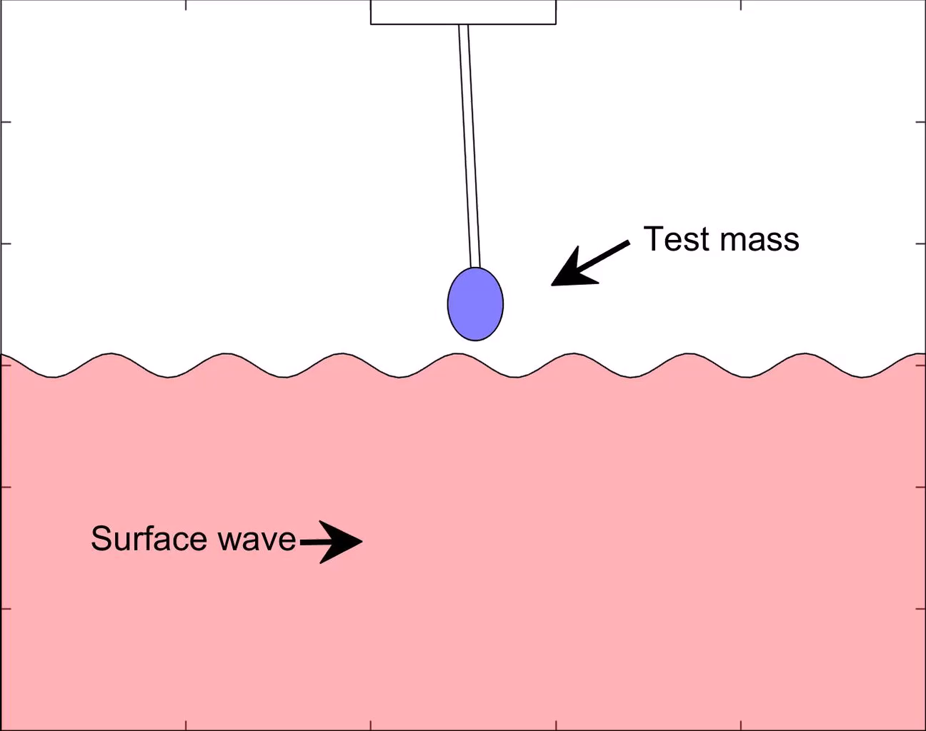
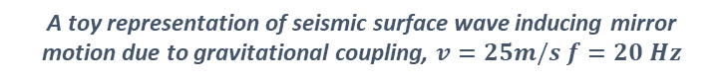
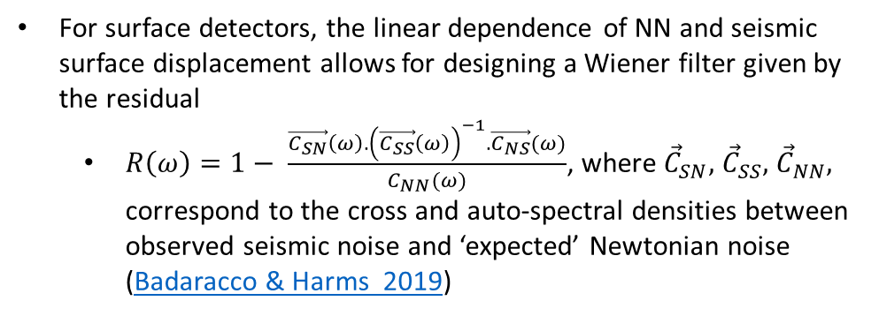
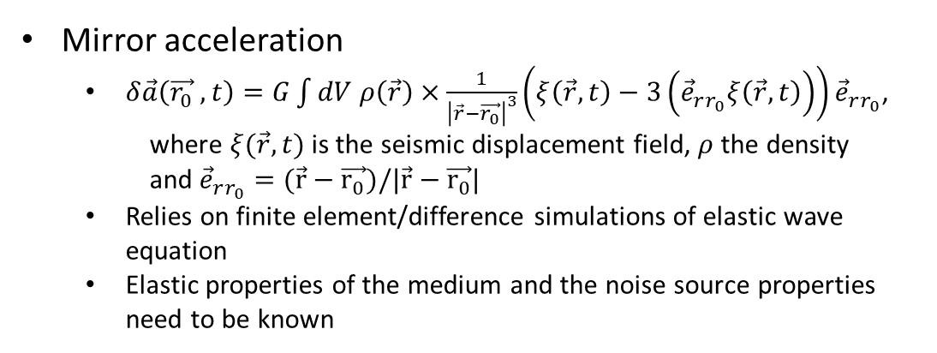
Newtonian noise - fundamentals
Mirror acceleration
$δ\vec{a}\left(\vec{r_{0}} ,t\right)=G\int{dV ρ\left(\vec{r}\right)×\frac{1}{{\left|\vec{r}−\vec{r_{0}}\right|}^{3}}}\left(ξ\left(\vec{r},t\right)−3\left({\vec{e}}_{rr_{0}}ξ\left(\vec{r},t\right)\right)\right){\vec{e}}_{rr_{0}}$,
where $ξ(\vec{r},t)$ is the seismic displacement field, $ρ$ the density
and ${\vec{e}}_{rr_{0}}=(\vec{r}−\vec{r_{0}})/|\vec{r}−\vec{r_{0}}|$
Relies on finite element/difference simulations of elastic wave equation
Elastic properties of the medium and the noise source properties need to be known
For surface detectors, the linear dependence of NN and seismic surface displacement allows for designing a Wiener filter given by the residual
$R\left(ω\right)=1− \frac{\vec{C_{SN}}\left(ω\right){.\left(\vec{C_{SS}}\left(ω\right)\right)}^{−1}.\vec{C_{NS}}(ω)}{C_{NN}(ω)}$, where ${\vec{C}}_{SN},$ ${\vec{C}}_{SS},$ ${\vec{C}}_{NN},$ correspond to the cross and auto-spectral densities between observed seismic noise and ‘expected’ Newtonian noise (Badaracco & Harms 2019)
A toy representation of seismic surface wave inducing mirror motion due to gravitational coupling, $v=25m/s$ $f=20 Hz$

Slide 4
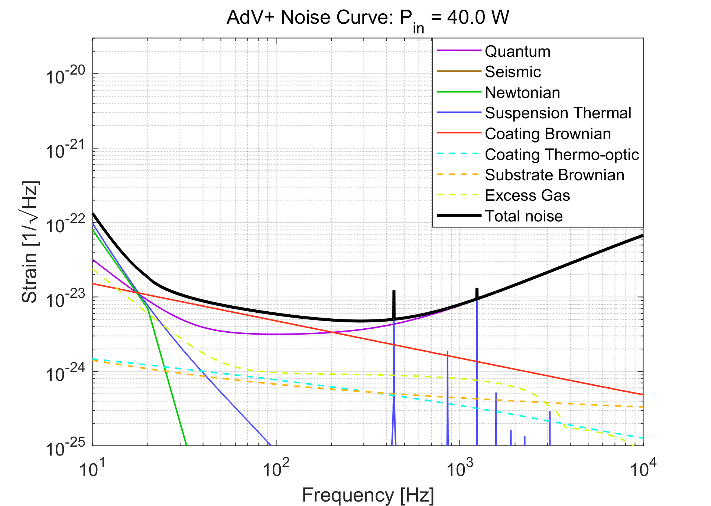
AdV+ Noise budget
Newtonian noise is expected to have dominant contribution to the O4b sensitivity (lower limit)

Slide 5
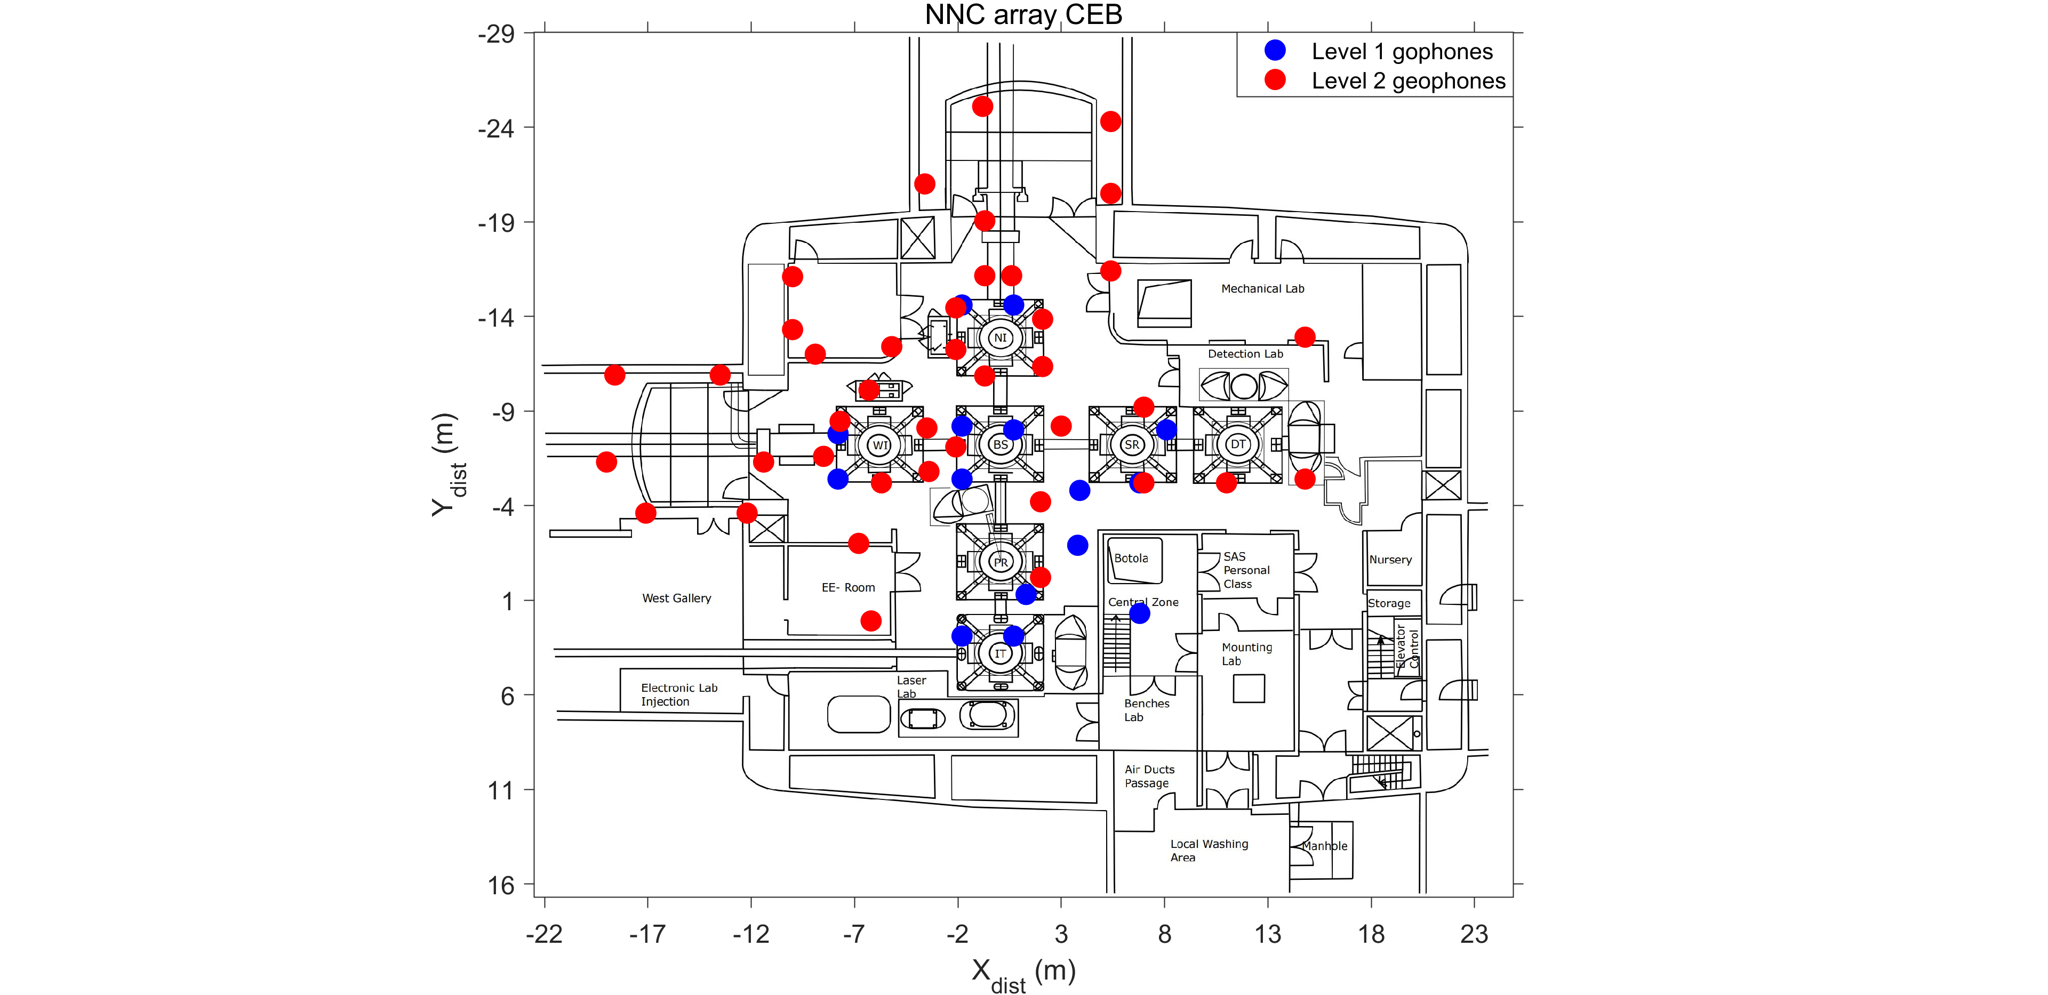
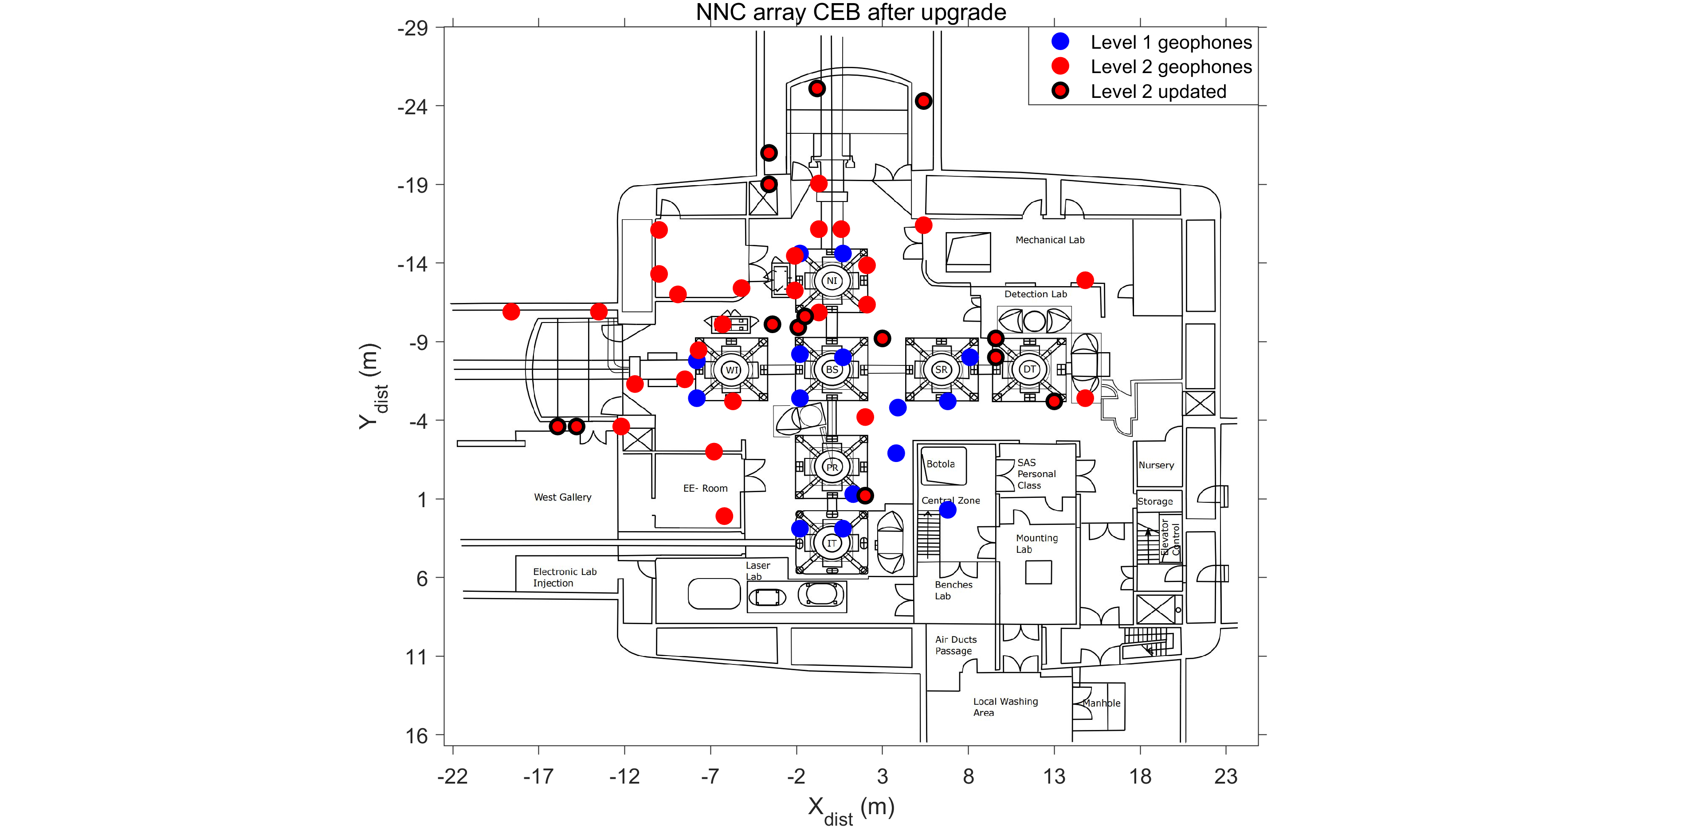
Newtonian noise cancellation – Central Building Array layout
A total of 55, 5 Hz geophones deployed in the central building (CEB)
15 geophones level 1
40 geophones level 2
Station positions were updated in May 2022 for optimal Newtonian noise cancellation
Data acquired continuously at 500 sps and integrated with Virgo DAQ
Geophone locations in the CEB prior to the upgrade in May 2022; The blue and the red dots represent the level 1 and level 2 geophones respectively
Geophone locations in the CEB after the upgrade in May 2022; Red dots with black edges correspond to the geophones whose positions were changed

Slide 6
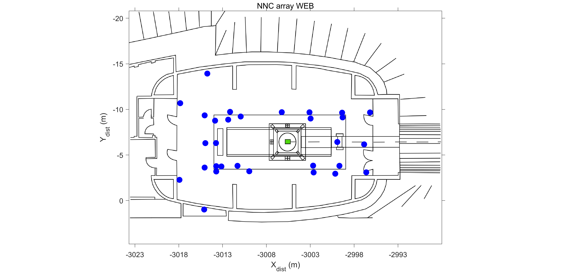
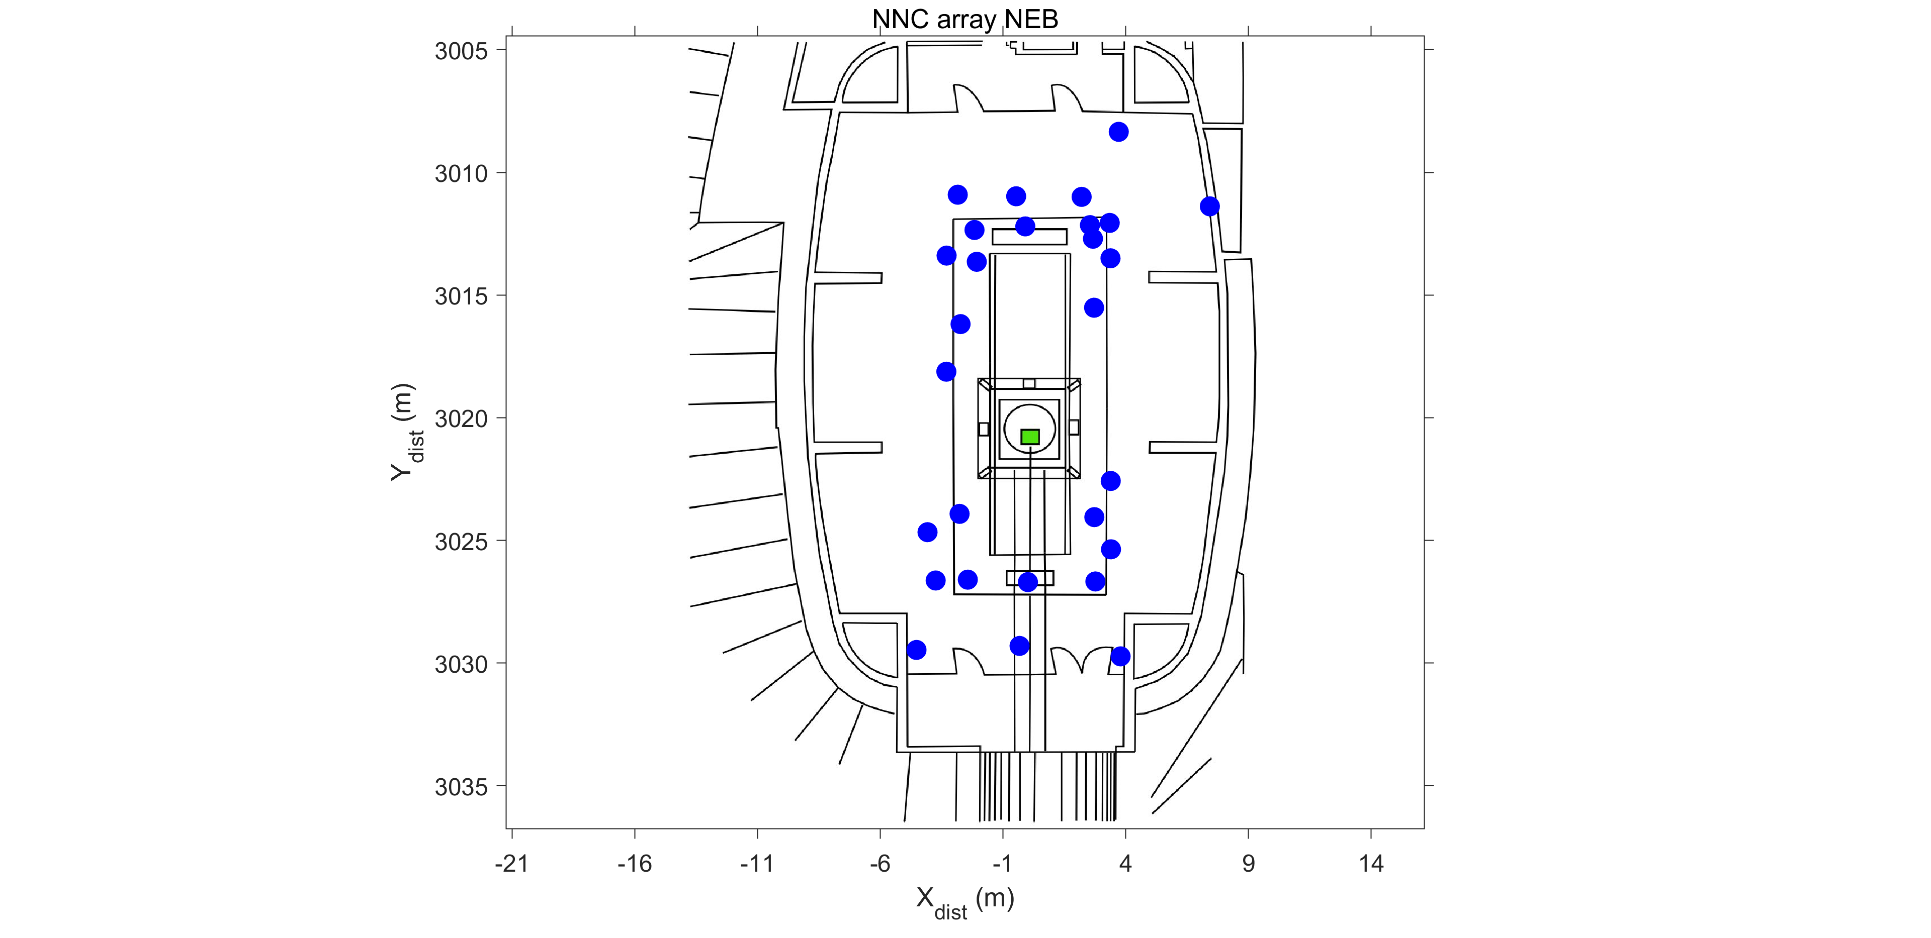
Newtonian noise cancellation – End Buildings Array layout
A total of 30, 5 Hz geophones deployed in the West End Building (WEB)
A total of 28, 5 Hz geophones deployed in the North End Building (NEB)
Geophone locations in the WEB represented using the blue dots; Coordinate system origin at the CEB beamsplitter
Geophone locations in the NEB represented using the blue dots; Coordinate system origin at the CEB beamsplitter

Slide 7
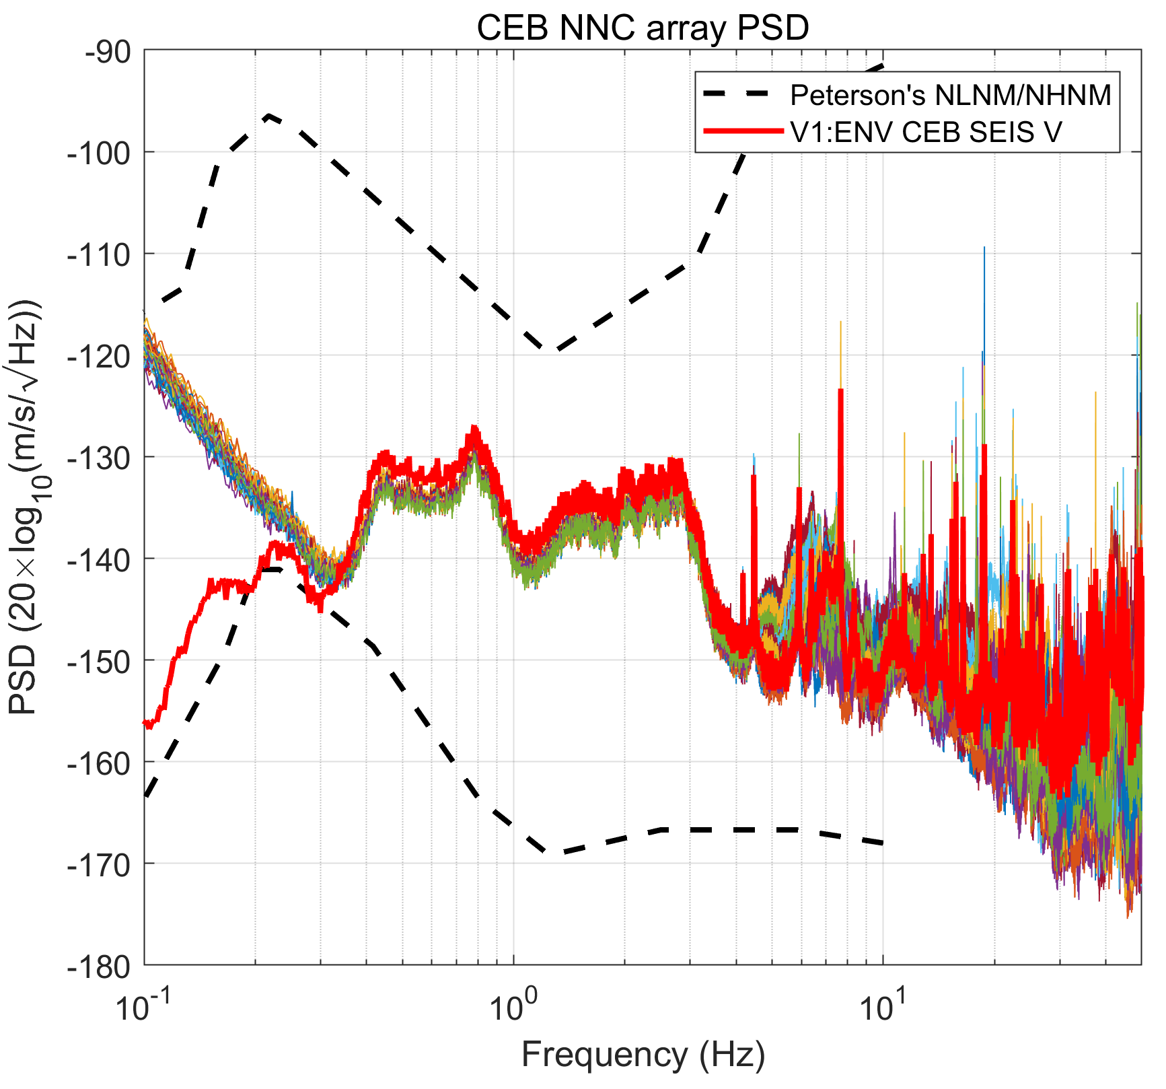
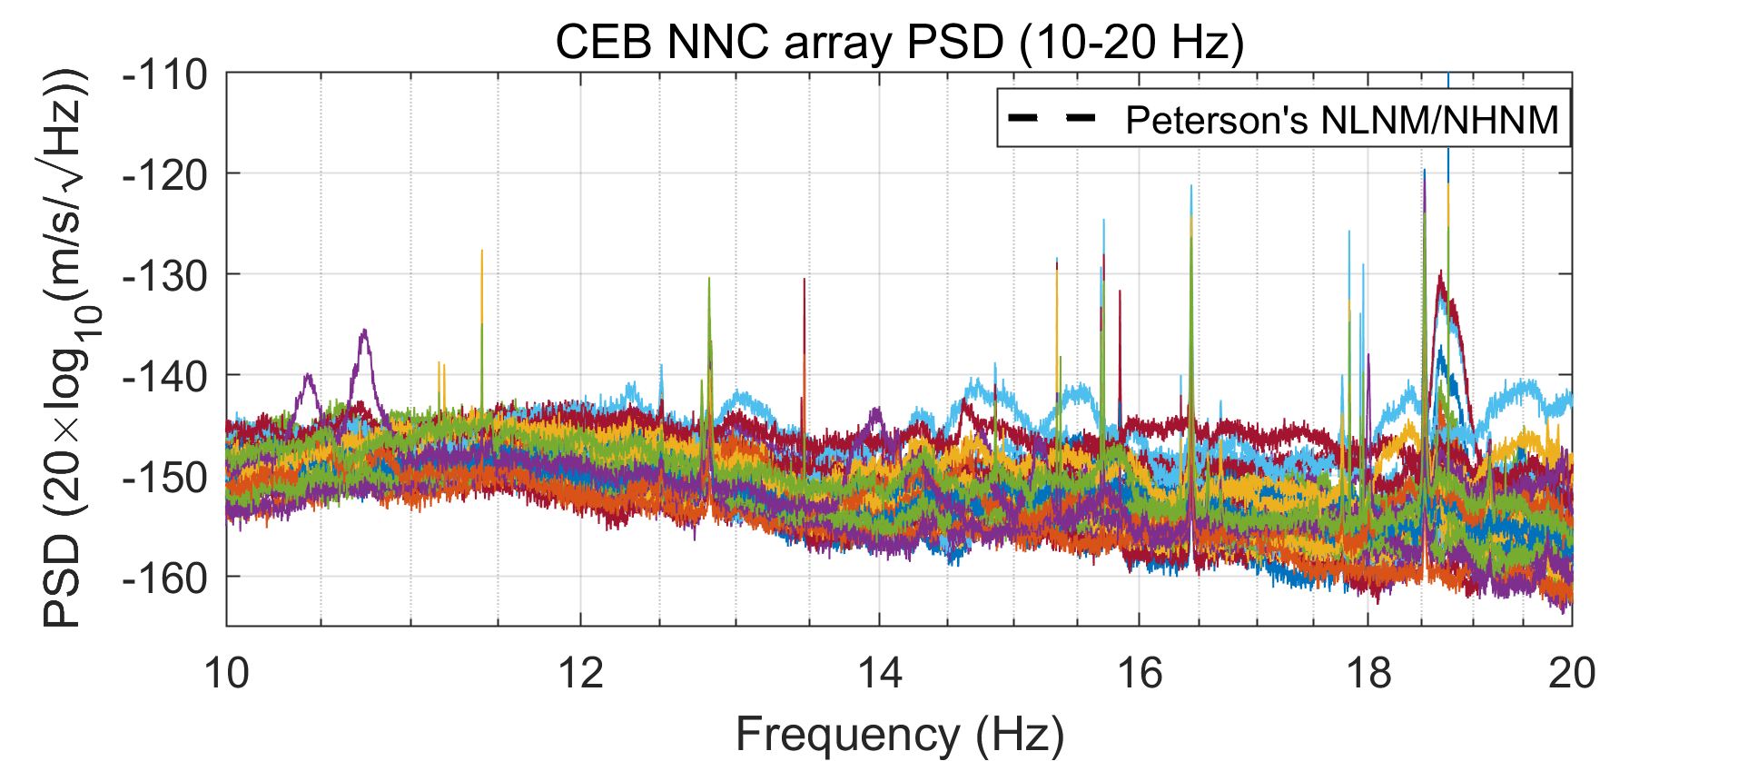
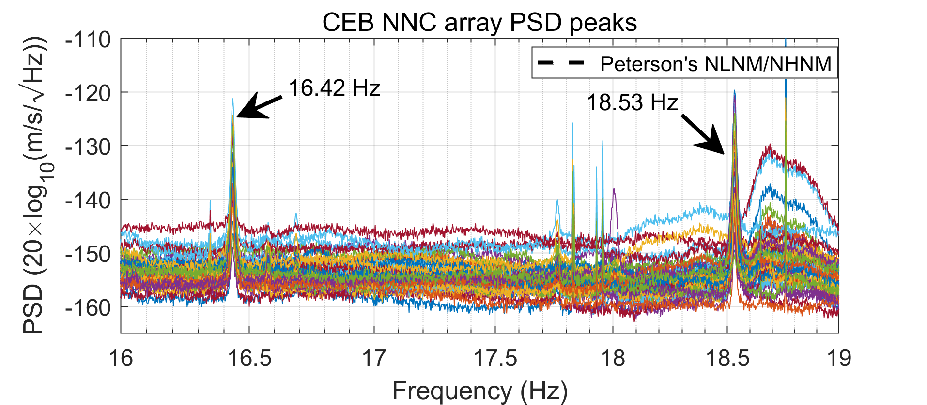
NNC array – Noise PSD characteristics
Performance of the NNC 5 Hz geophones are comparable to the GURALP seismometer in the CEB down to 0.4 Hz
Spatial variation between 10-20 dB for frequencies between 10-20 Hz
Both broadband and sharp spectral noise observed
`Mode of the PSD estimates for the CEB NNC geophones and the CEB GURALP seismometer (red curve) starting at GPS time 1359417600; PSD win length 600 s, 300 s overlap, total duration 86400 s
Seismic noise in band 10-40 Hz is composed of broadband as well as sharp spectral noise originating from machines at the site

Slide 8
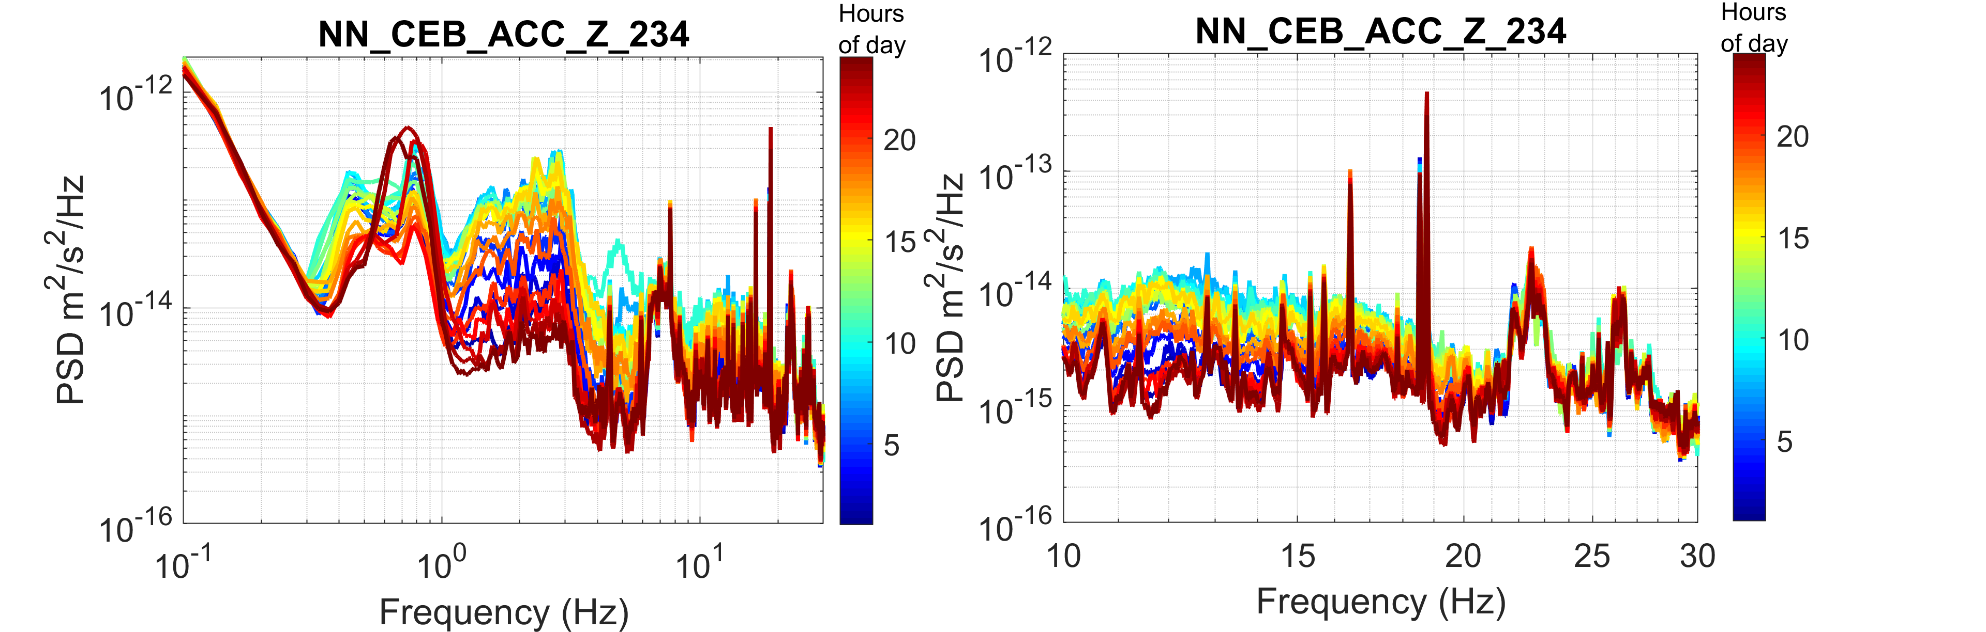
Noise characteristics – day-night variation
Maximum seismic noise PSDs are observed at around noon every-day
An order of magnitude difference in PSDs can be observed between noisy and quiet times, especially in the frequency band 2-6 Hz
For frequencies above 10 Hz a factor 4-5 difference in PSDs are observed
Above 20 Hz most noises are generated by machinery at the site and a day-night variation is not observed
Average PSDs estimated every hour of the day showing strong diurnal variation between 2-15 Hz
Average PSDs estimated every hour of the day showing weak or no diurnal variation for frequencies greater than 25 Hz

Slide 9
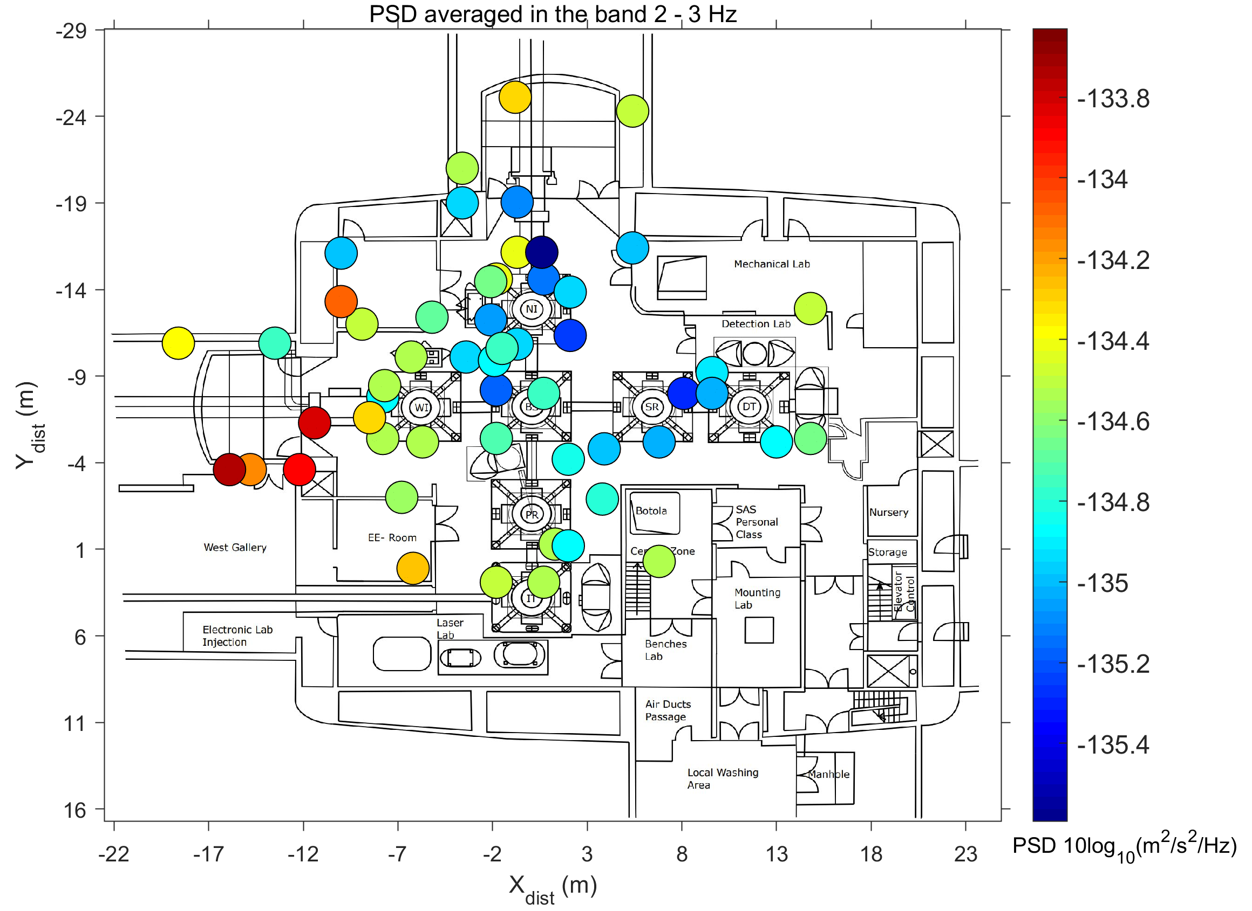
Noise PSD characteristics – Spatial variation in the 2-3 Hz band
PSDs computed every 600 s with an overlap of 300 s between consecutive windows
Averaged for a week of data
Starting time – 1359417618 s
Spatial variation of the noise PSDs are within 2 dBs
Noise originates far-away from sources like roads, bridges in the vicinity of the site
Little attenuation while propagating through the NNC array
Spatial distribution of seismic noise PSDs averaged in the frequency band 2-3 Hz.

Slide 10
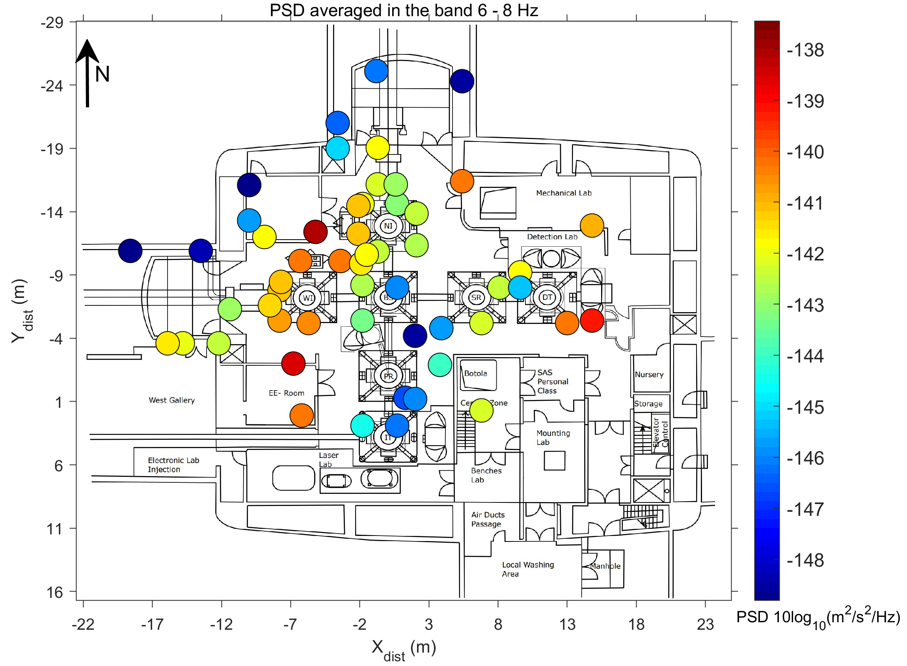
Noise PSD characteristics – Spatial variation in the 6 - 8 Hz band
Noise PSDs averaged in the frequency band 6-8 Hz show a variation of about 10 dB
Unlike 2 -3 Hz band where a maximum variation of about 2 dB was observed
No prominent directional bias in the PSD distribution
Spatial distribution of seismic noise PSDs averaged in the frequency band 6-8 Hz.

Slide 11
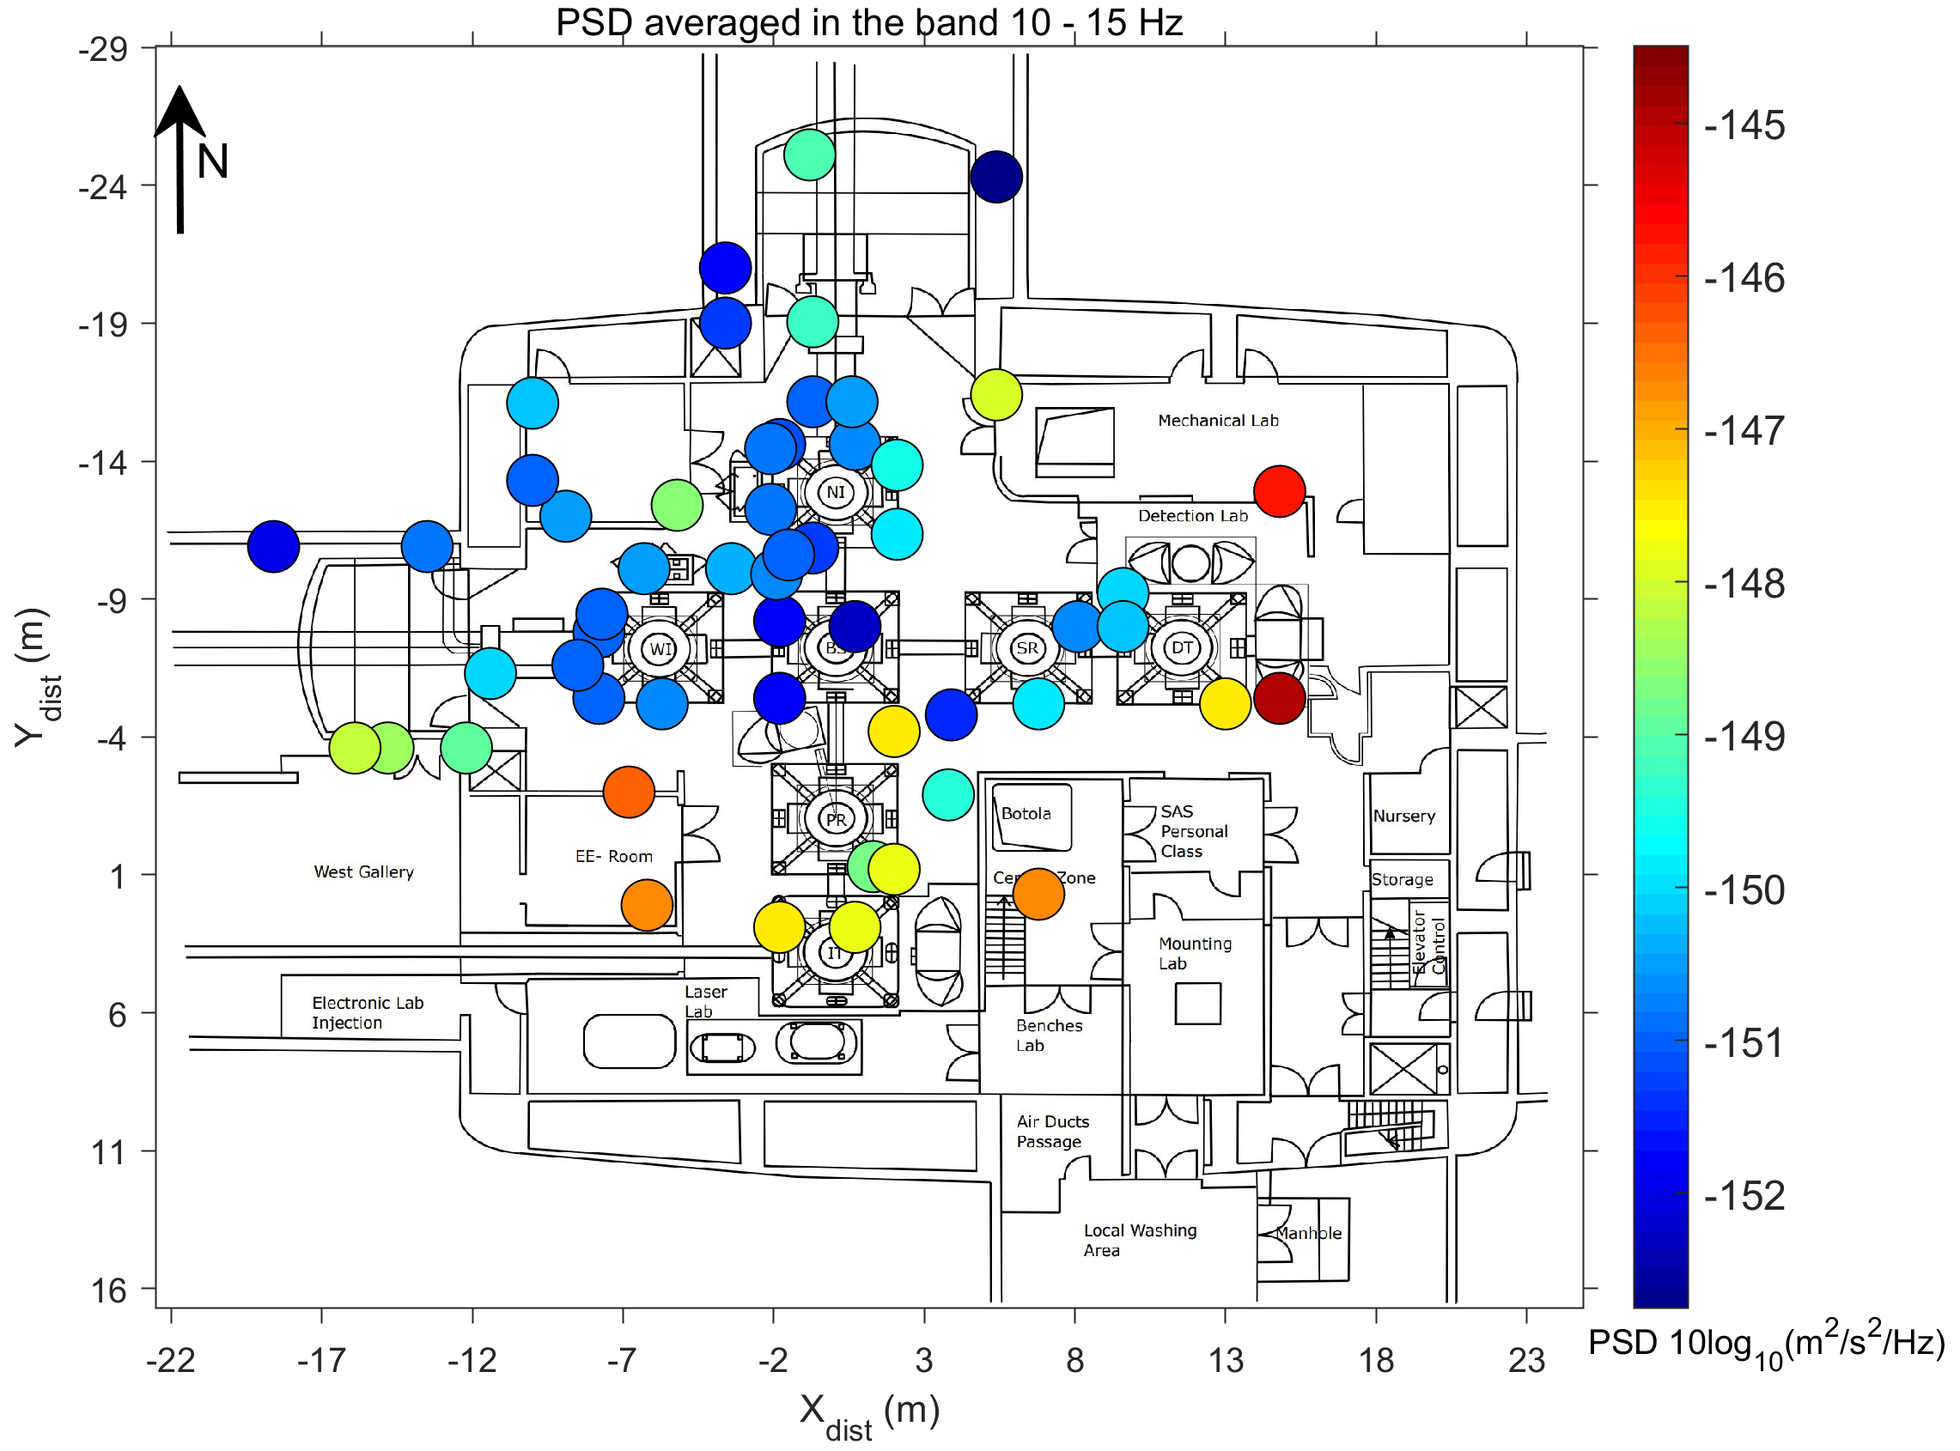
Noise PSD characteristics – Spatial variation in the 10 - 15 Hz band
Noise PSDs averaged in the frequency band 10-15 Hz show a variation of about 7 dB
About 2-3 dB lower than that observed for the 6-8 Hz band
Noise propagation “dominantly” SE - NW
Spatial distribution of seismic noise PSDs averaged in the frequency band 10-15 Hz.

Slide 12
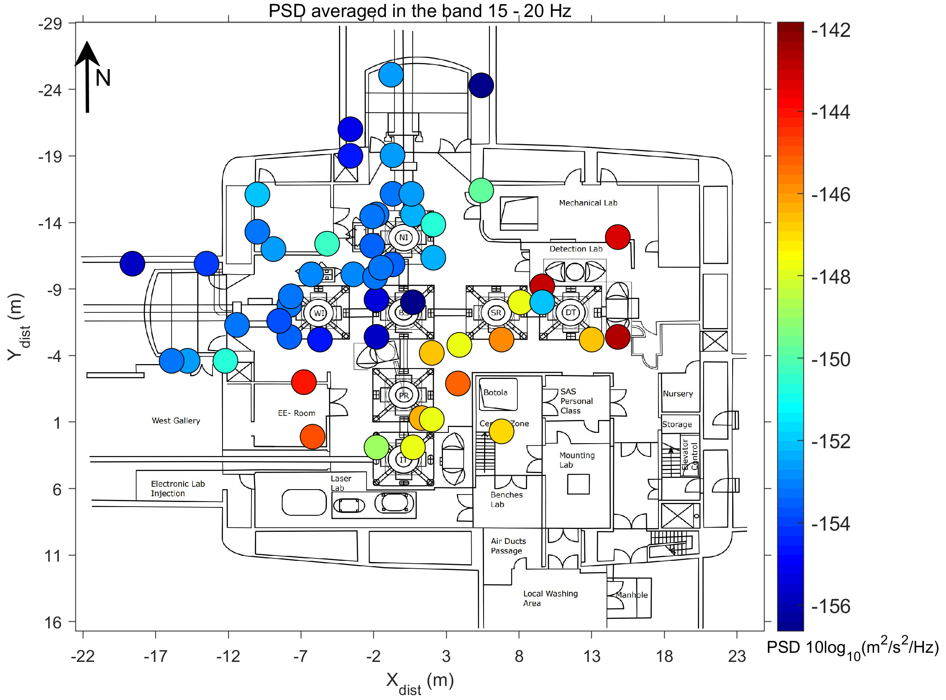
Noise PSD characteristics – Spatial variation in the 15 - 20 Hz band
Noise PSDs averaged in the frequency band 15-20 Hz show a variation of about 15 dB
About 5 dB higher than the 10-15 Hz band
Similar to the 10- 15 Hz band, noise propagation “dominantly” SE - NW
Spatial distribution of seismic noise PSDs averaged in the frequency band 15-20 Hz.

Slide 13
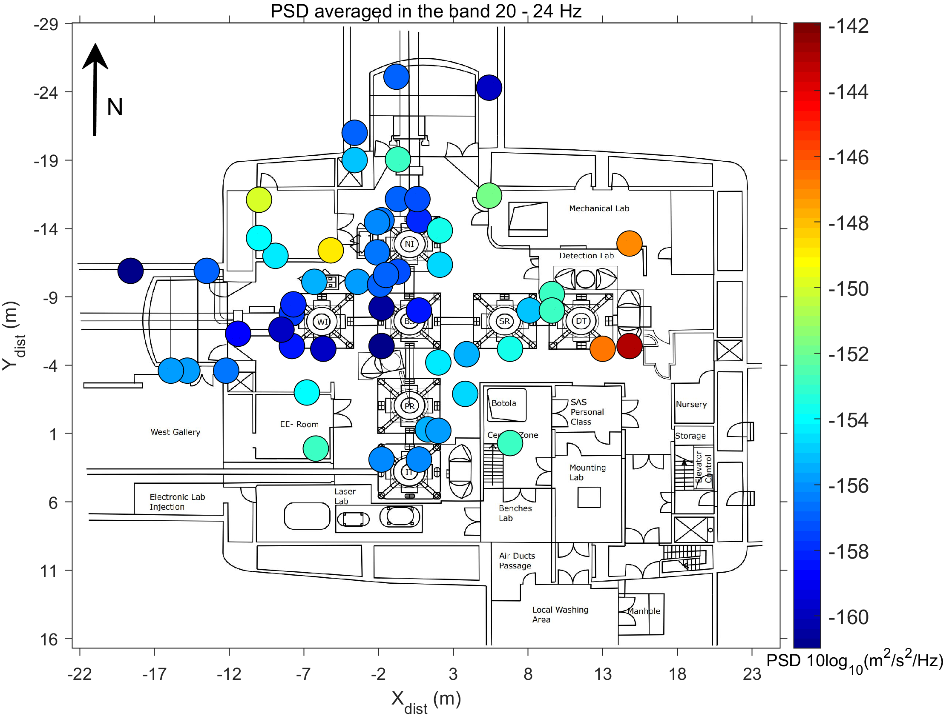
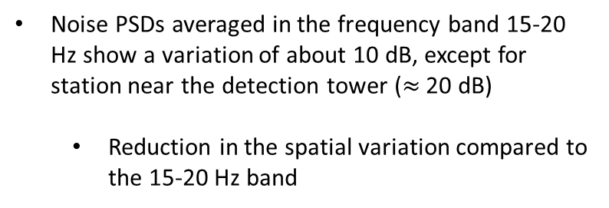
Noise PSD characteristics – Spatial variation in the 20 - 24 Hz band
Noise PSDs averaged in the frequency band 15-20 Hz show a variation of about 10 dB, except for station near the detection tower ($≈$ 20 dB)
Reduction in the spatial variation compared to the 15-20 Hz band
Similar to the 10- 15 Hz band, noise propagation “dominantly” SE – NW, E-W
Spatial distribution of seismic noise PSDs averaged in the frequency band 20-24 Hz.

Slide 14
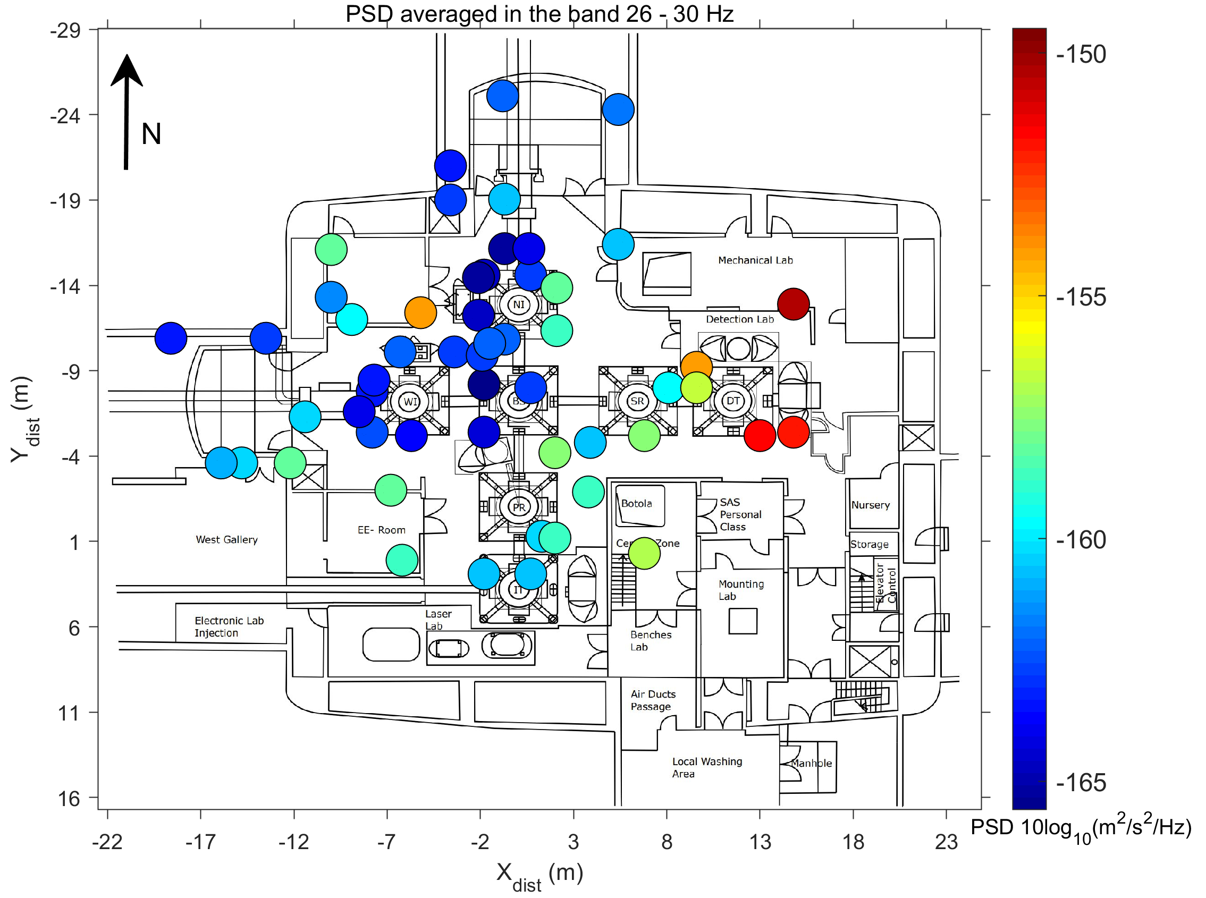
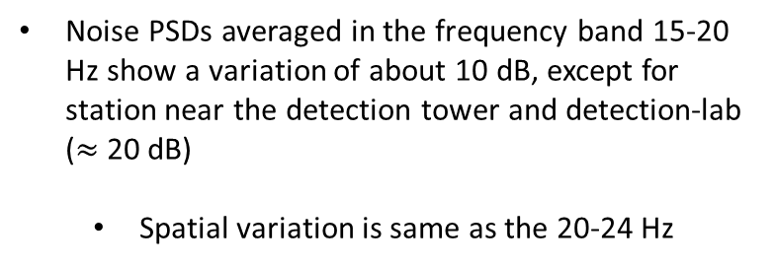
Noise PSD characteristics – Spatial variation in the 26 - 30 Hz band
Noise PSDs averaged in the frequency band 15-20 Hz show a variation of about 10 dB, except for station near the detection tower and detection-lab ($≈$ 20 dB)
Spatial variation is same as the 20-24 Hz
Noise propagation “dominantly” SE – NW, E-W
Spatial distribution of seismic noise PSDs averaged in the frequency band 26-30 Hz.

Slide 15
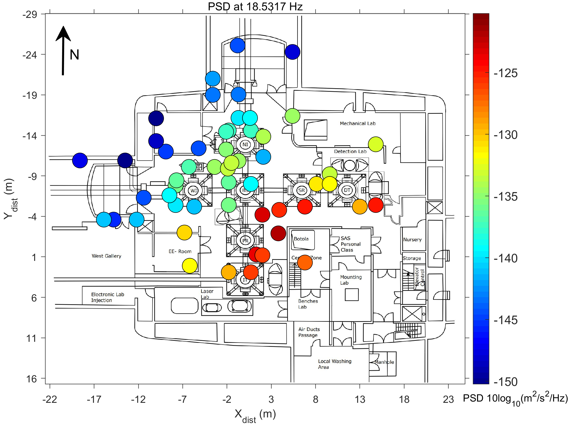
Noise PSD characteristics – Spatial variation for the 18.5 Hz noise peak
Spatial variation of seismic noise PSDs can be used to infer location of noise sources within the building
String PSD variation of about 30 dB observed
Spatial variation of the noise PSDs for the 18.5317 Hz shows a dominant SSE-NNW
Supply fan of the Air Handling Unit located in the CEB cleanroom has already been identified to be the source of this noise (https://tds.virgo-gw.eu/?content=3&r=20911)
Spatial distribution of seismic noise PSDs for the peak at 18.5317 Hz

Slide 16
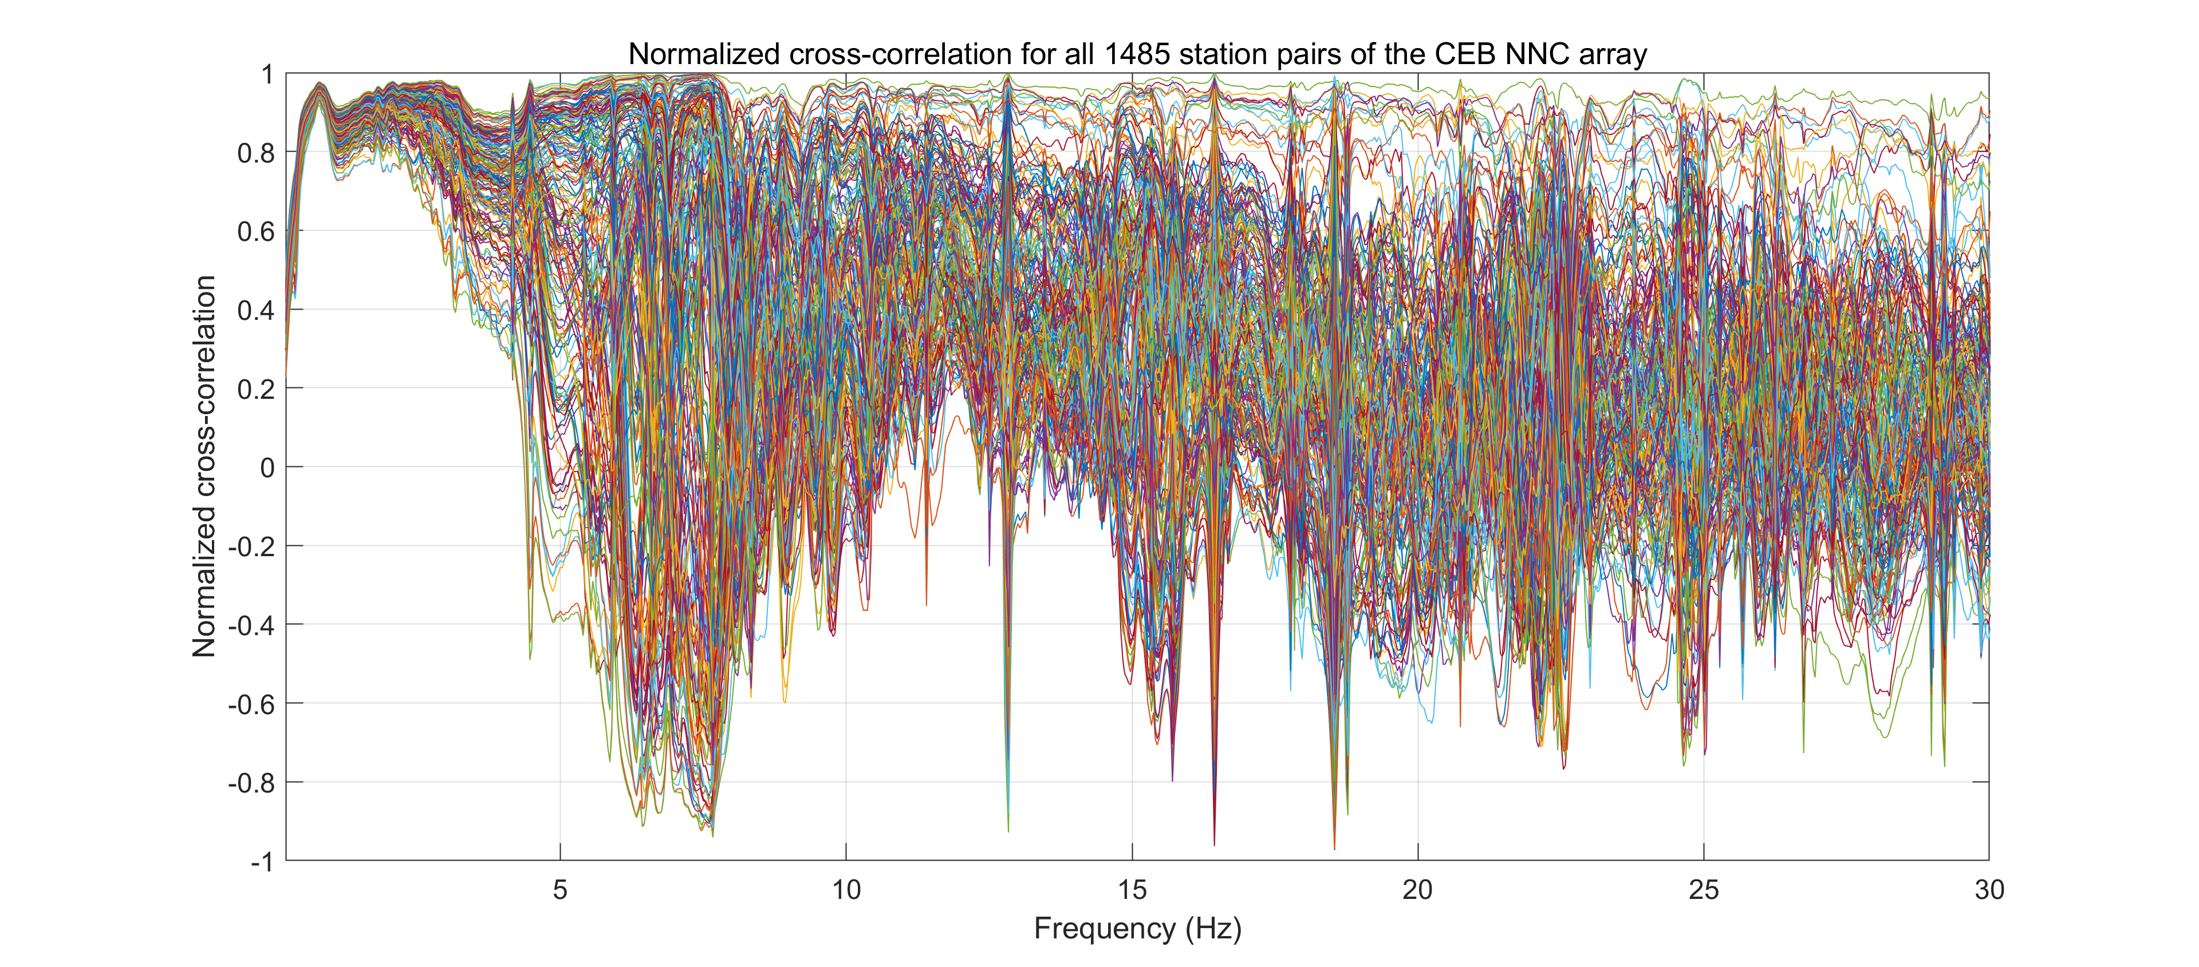
Noise phase characteristics – normalized interstation cross-correlations
Normalized cross-correlation between stations $i$ and $j$ for $M$ windows can be expressed as
$CC_{ij}=real\left(\frac{\sum_{k=1}^{M}{X_{i}\left(f\right)X_{j}^{∗}\left(f\right)}}{\sqrt{\sum_{k=1}^{M}{X_{i}\left(f\right)X_{i}^{∗}\left(f\right)}\sum_{k=1}^{M}{X_{j}\left(f\right)X_{j}^{∗}\left(f\right)}}}\right)$, where $X\left(f\right)=fft(x(t))$
Cross-correlations >=0.8 for the frequency band 0.4-3 Hz
Dominated by anisotropic distribution of surface wave sources
Mixture of horizontally and near-vertical propagating waves (body waves)
Cross-correlation functions with no zero-crossing
Normalized frequency-domain cross-correlation of all 1485 station pairs in the CEB NNC array

Slide 17
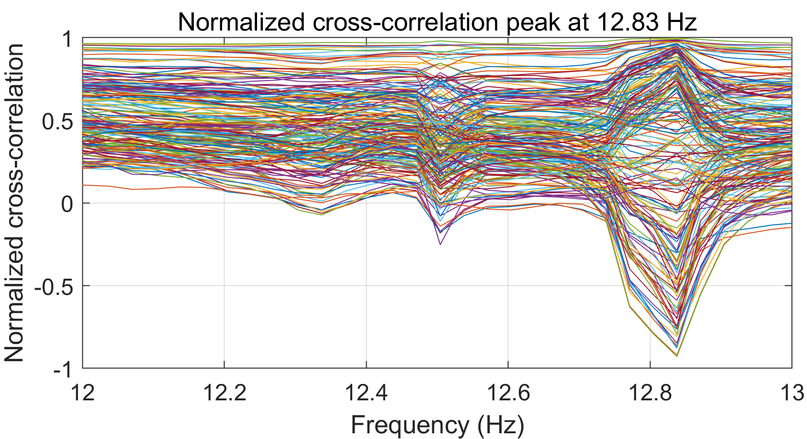
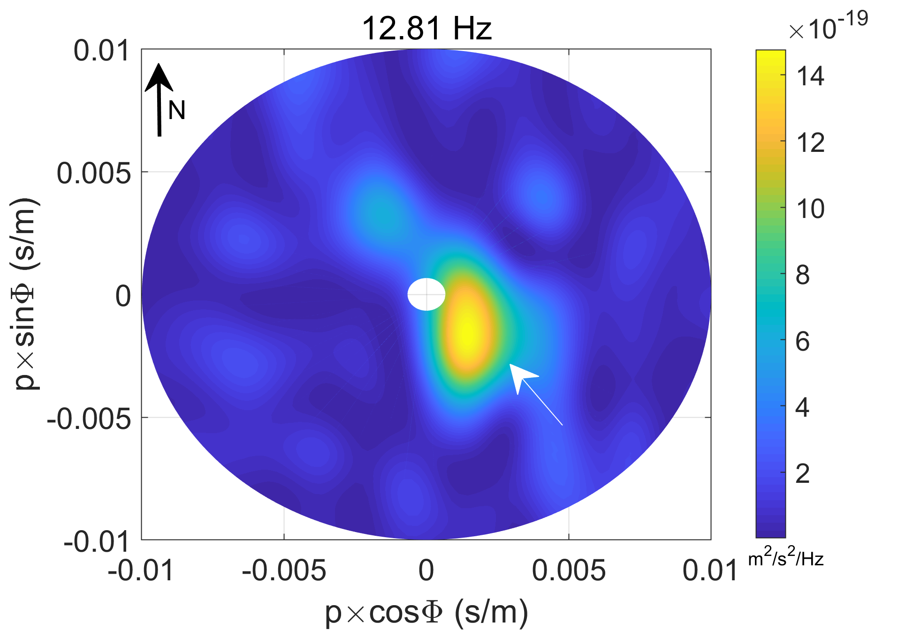
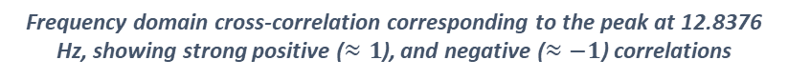
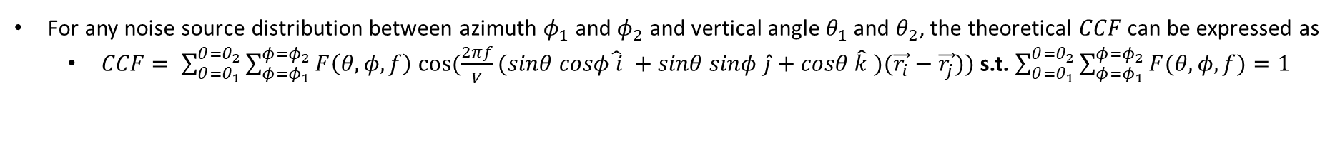
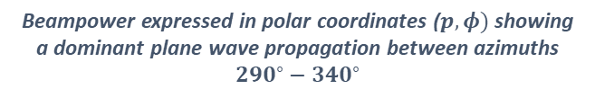
Noise phase characteristics – cross-correlations for anisotropic noise source distribution
For any noise source distribution between azimuth $φ_{1}$ and $φ_{2}$ and vertical angle $θ_{1}$ and $θ_{2}$, the theoretical $CCF$ can be expressed as
$CCF= \sum_{θ=θ_{1}}^{θ=θ_{2}}{\sum_{φ=φ_{1}}^{φ=φ_{2}}{F\left(θ,φ,f\right) cos⁡(\frac{2πf}{V}(sinθ cosφ\hat{ i} +sinθ sinφ \hat{j}+cosθ \hat{k} )(\vec{r_{i}}−\vec{r_{j}}))}}$ s.t. $\sum_{θ=θ_{1}}^{θ=θ_{2}}{\sum_{φ=φ_{1}}^{φ=φ_{2}}{F(θ,φ,f)}}=1$
Beamform
Frequency domain cross-correlation corresponding to the peak at 12.8376 Hz, showing strong positive ($≈1$), and negative ($≈−1$) correlations
Beampower expressed in polar coordinates ($p,φ)$ showing a dominant plane wave propagation between azimuths $290^{∘}−340^{∘}$

Slide 18
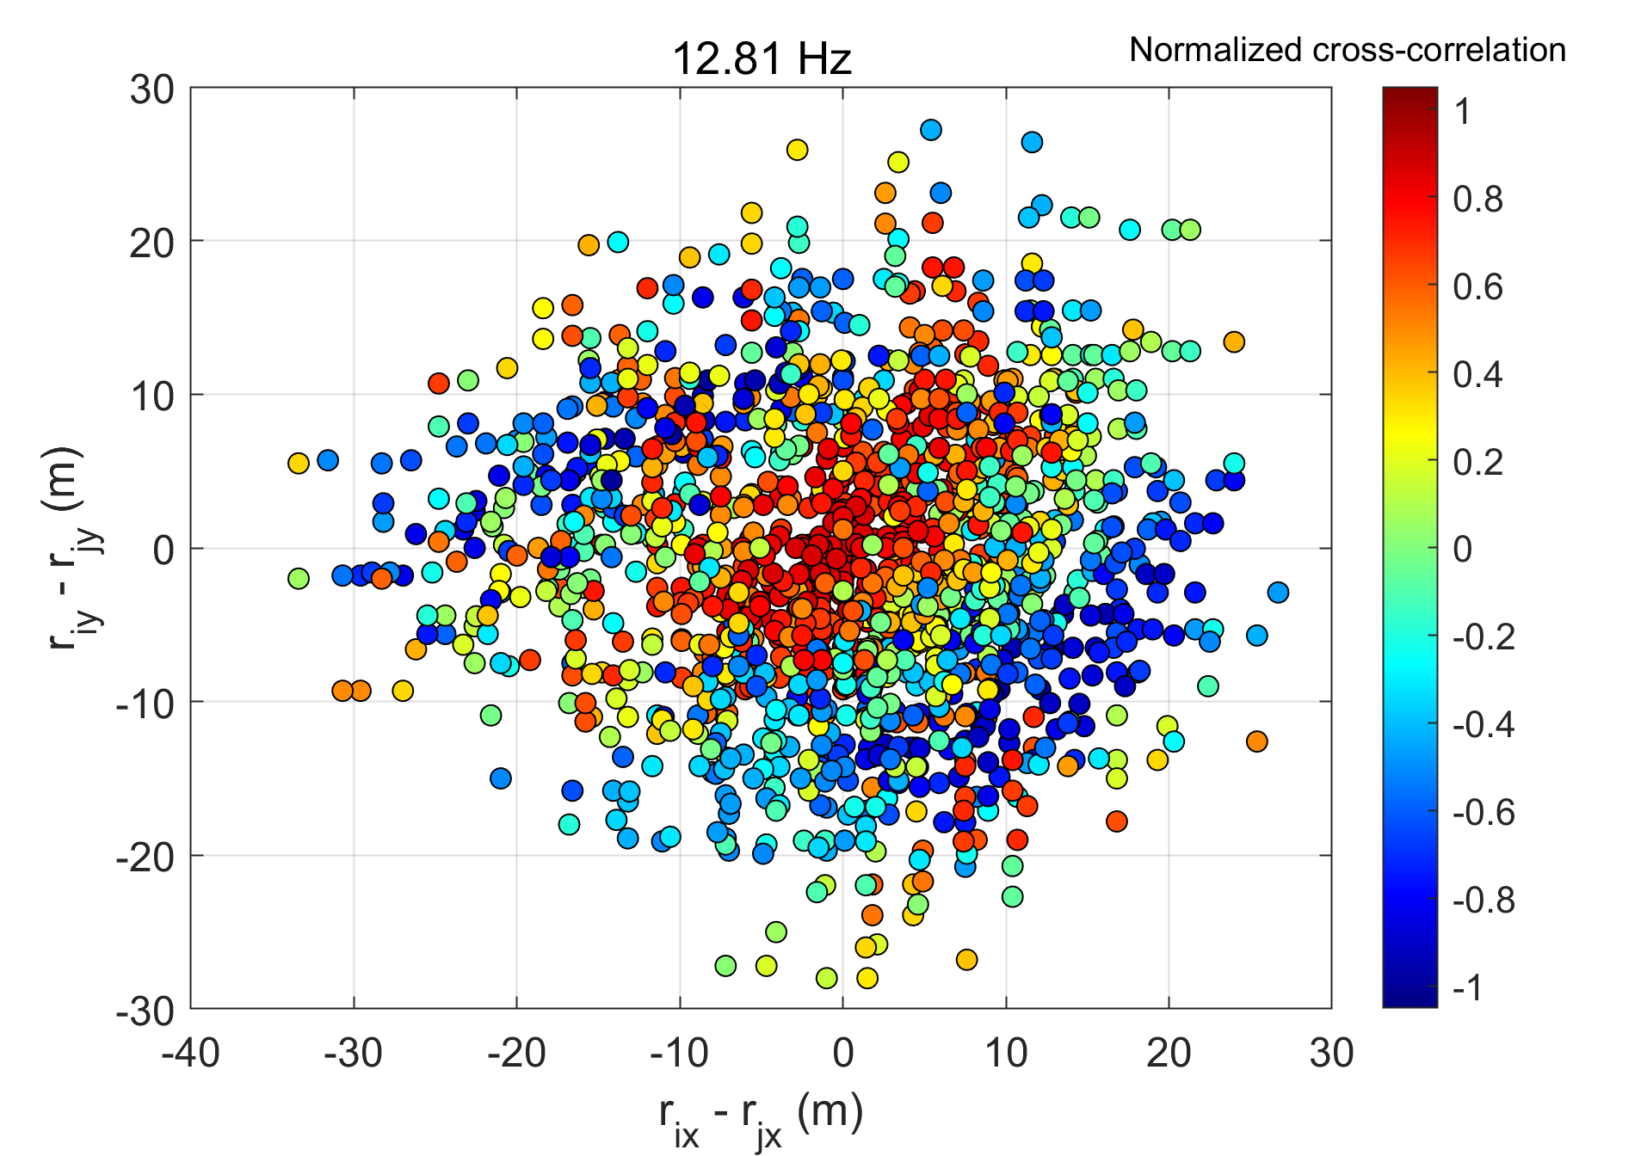
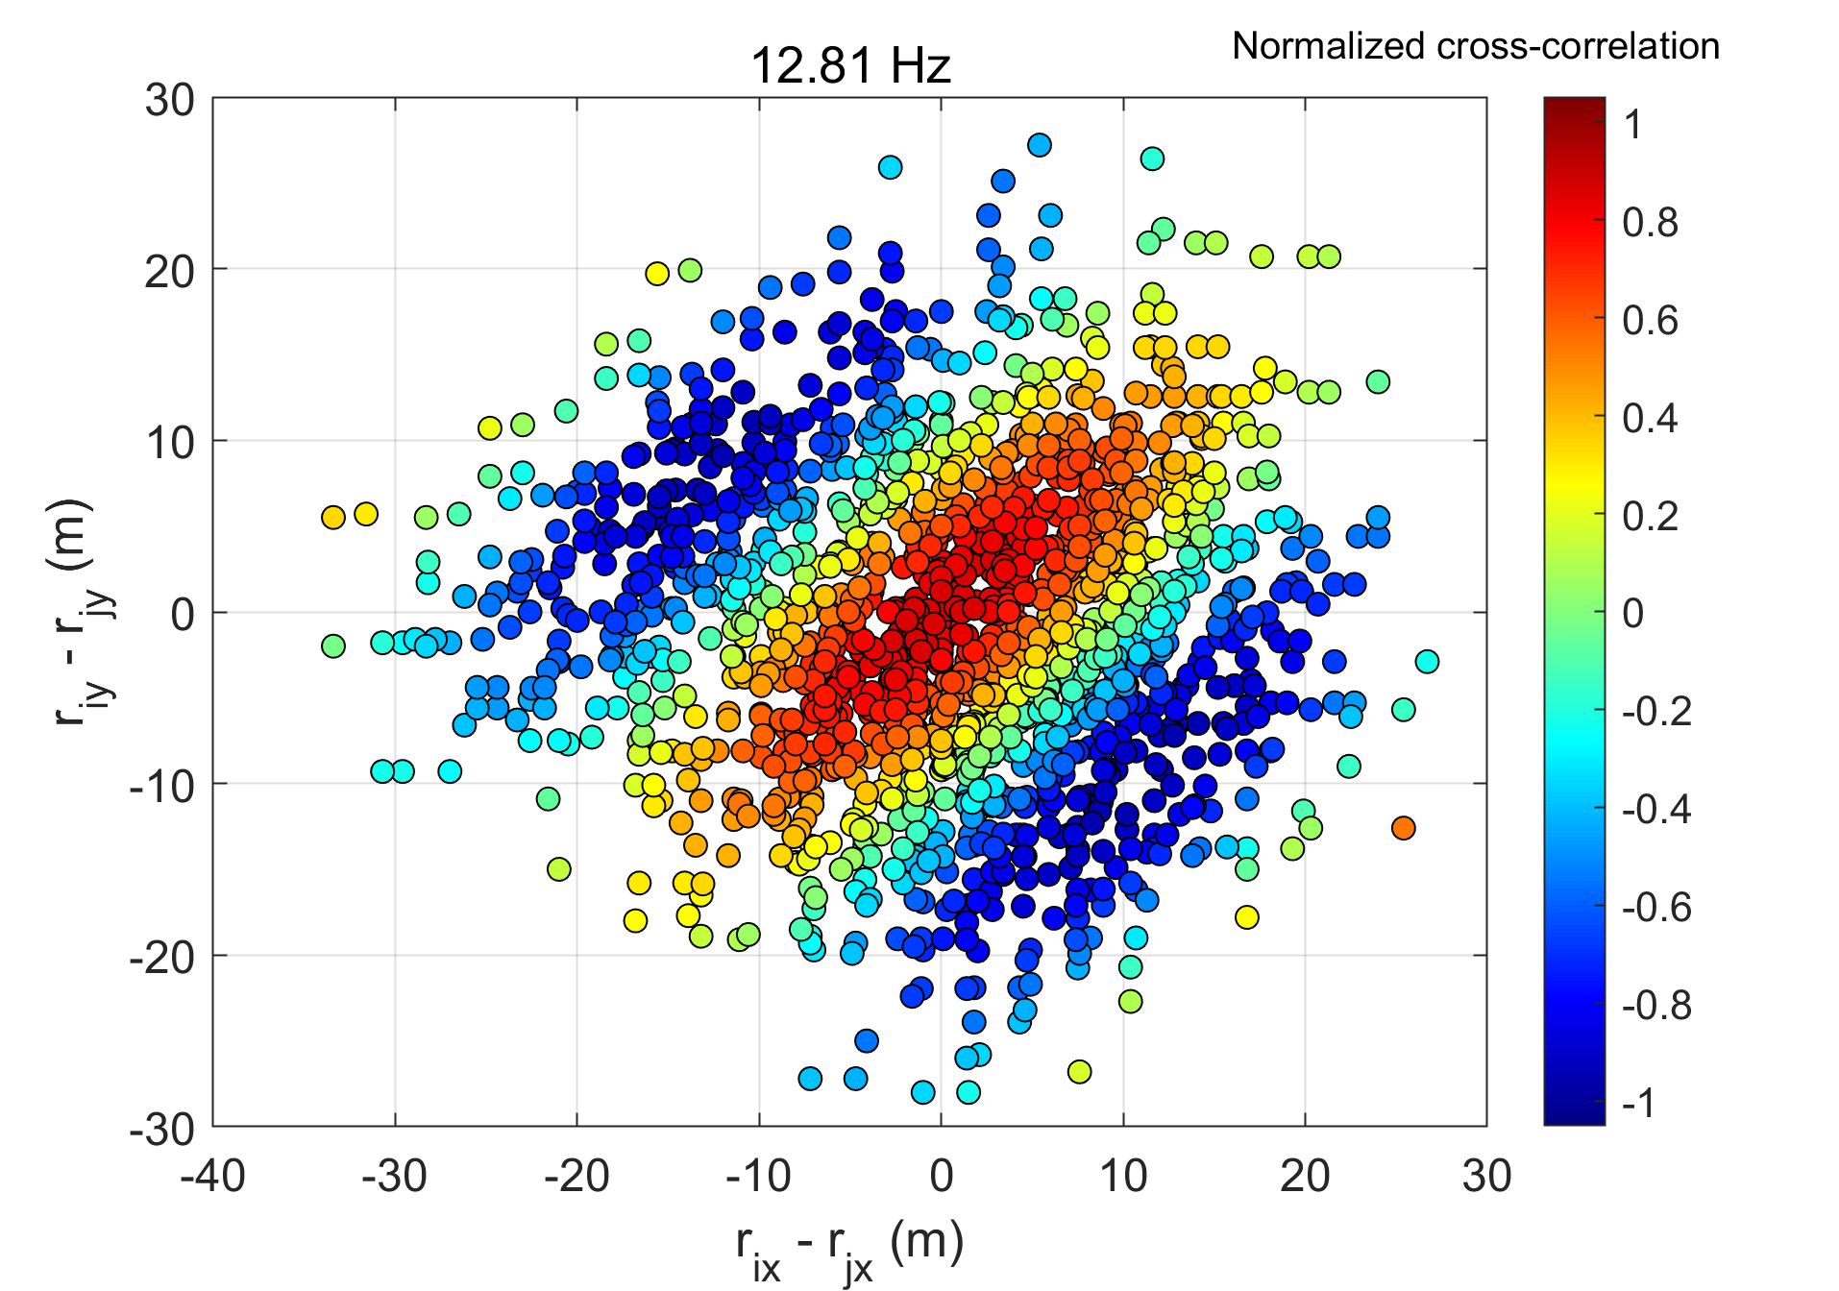
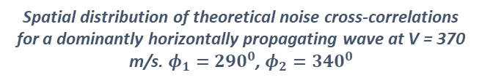
Noise phase characteristics – spatial distribution of cross-correlation for 12.81 Hz peak
Observed cross-correlations
Estimated cross-correlations
Spatial distribution of noise cross-correlations at 12.8 Hz show a horizontally propagating wave
Spatial distribution of theoretical noise cross-correlations for a dominantly horizontally propagating wave at V = 370 m/s. $φ_{1}=290^{0}$, $φ_{2}=340^{0}$

Slide 19
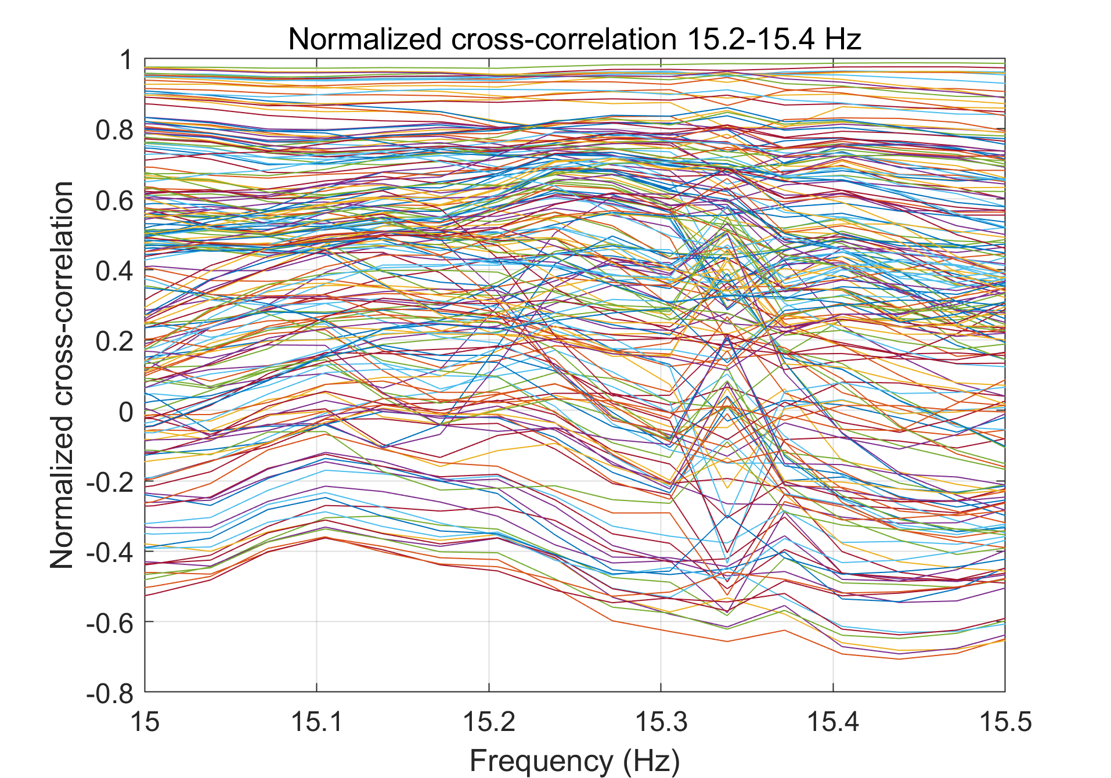
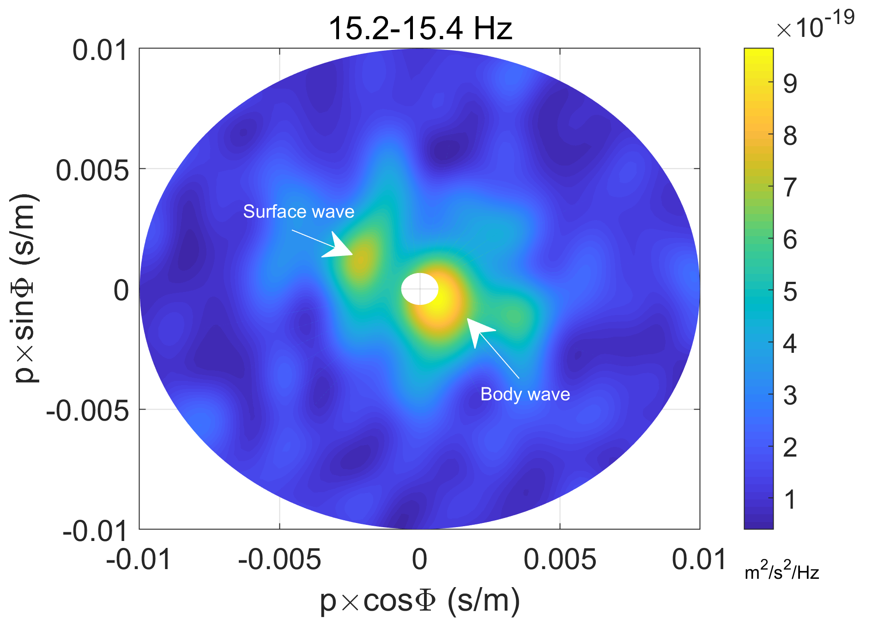
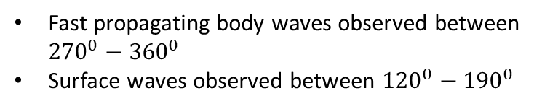
Noise phase characteristics – mixture of body and surface waves
Beamform
Cross-correlations in the frequency band 15.2 – 15.4 Hz is a mixture of sharp peaks (surface wave) and broadband noise (body waves)
Fast propagating body waves observed between ${270}^{0}−{360}^{0}$
Surface waves observed between ${120}^{0}−{190}^{0}$

Slide 20
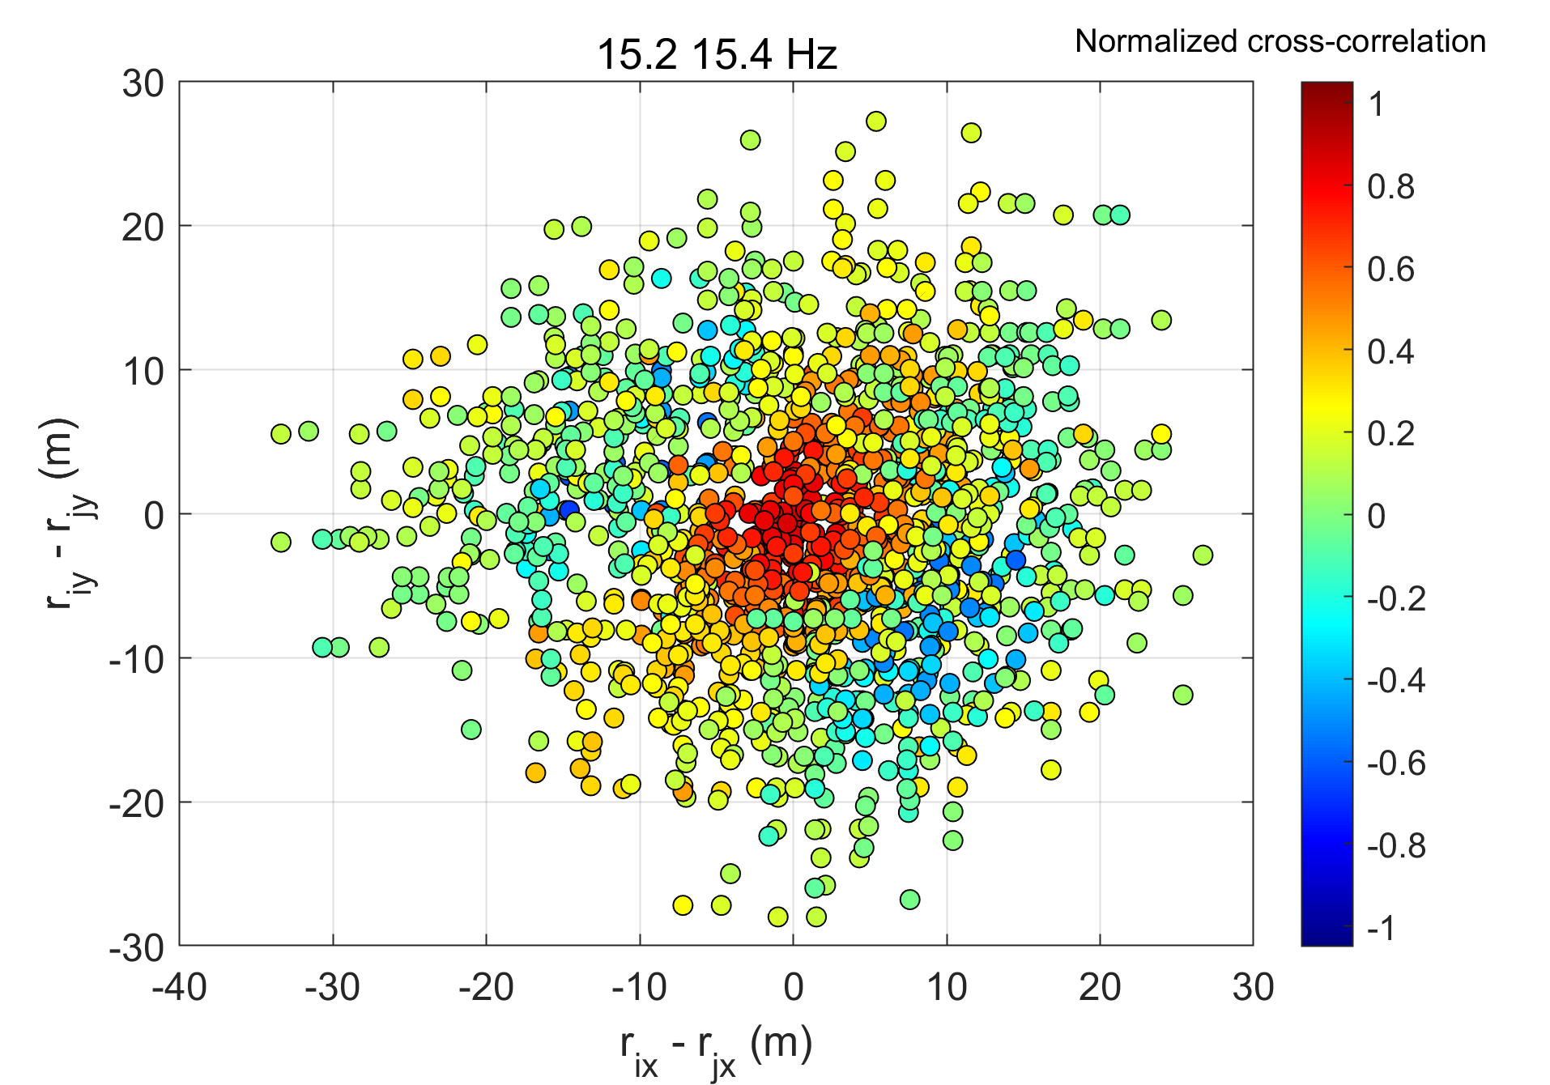
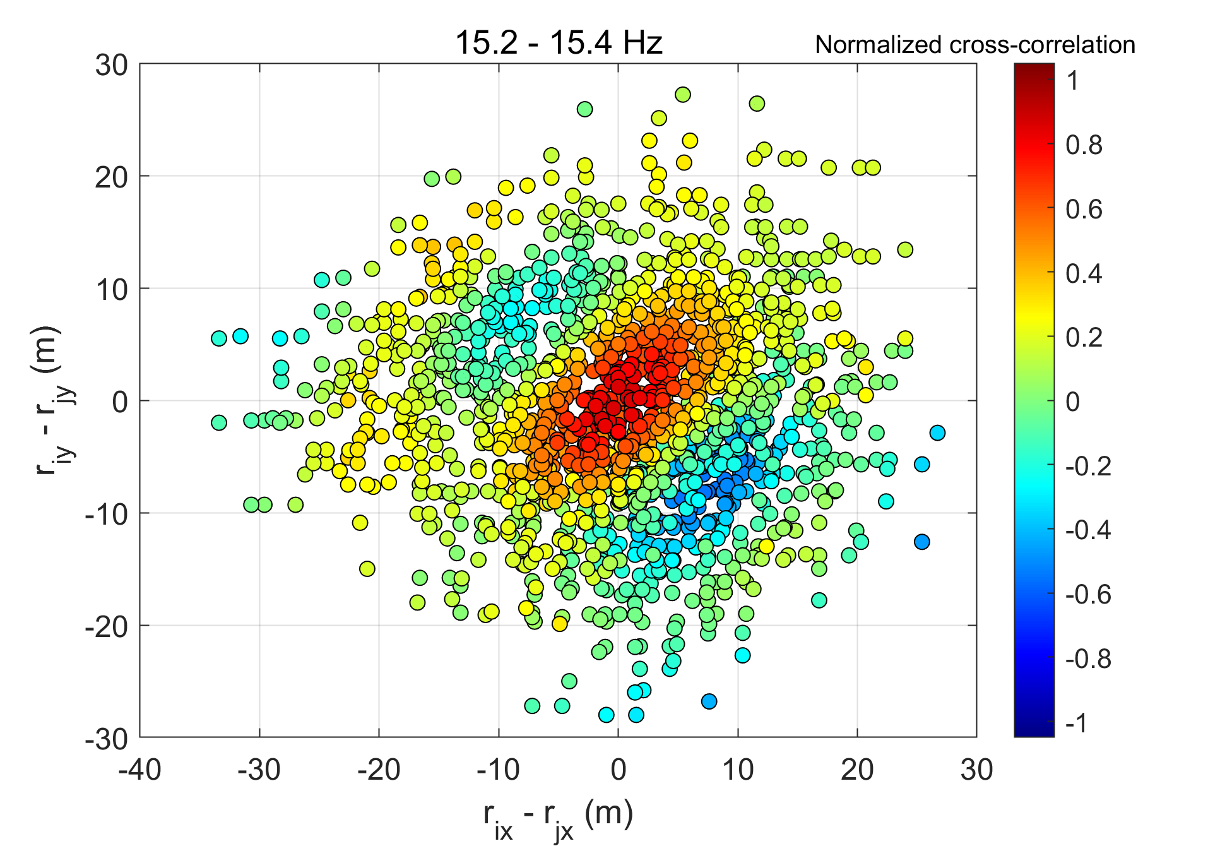
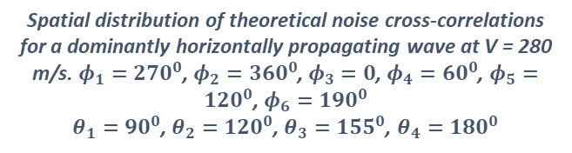
Noise phase characteristics – spatial distribution of cross-correlation for 15-2-15.4 Hz peak
Observed cross-correlations
Estimated cross-correlations
Spatial distribution of noise cross-correlations between 15-2 – 15.4 Hz showing a combination of surface wave and body waves
Spatial distribution of theoretical noise cross-correlations for a dominantly horizontally propagating wave at V = 280 m/s. $φ_{1}=270^{0}$, $φ_{2}=360^{0}$, $φ_{3}=0$, $φ_{4}=60^{0}$, $φ_{5}=120^{0}$, $φ_{6}=190^{0}$
$θ_{1}=90^{0}$, $θ_{2}=120^{0}$, $θ_{3}=155^{0}$, $θ_{4}=180^{0}$

Slide 21
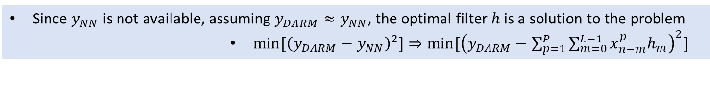
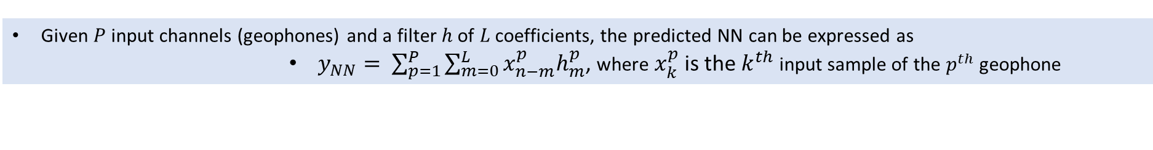
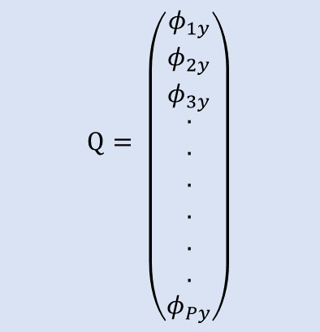
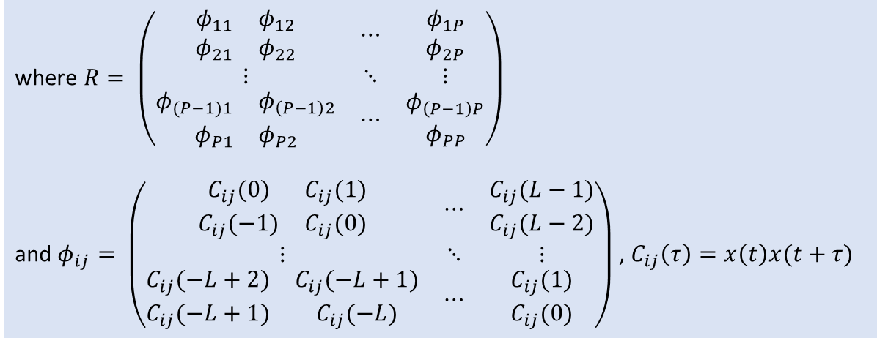
Wiener filter – NN prediction
Given $P$ input channels (geophones) and a filter $h$ of $L$ coefficients, the predicted NN can be expressed as
$y_{NN}= \sum_{p=1}^{P}{\sum_{m=0}^{L}{x_{n−m}^{p}h_{m}^{p}}}$, where $x_{k}^{p}$ is the $k^{th}$ input sample of the $p^{th}$ geophone
Since $y_{NN}$ is not available, assuming $y_{DARM}≈y_{NN}$, the optimal filter $h$ is a solution to the problem
$min⁡[{\left(y_{DARM}−y_{NN}\right)}^{2}]$ $⇒min⁡[{\left(y_{DARM}−\sum_{p=1}^{P}{\sum_{m=0}^{L−1}{x_{n−m}^{p}h_{m}}}\right)}^{2}]$
Using the Wiener-Hopf formulation, the optimal filter $h$ can be expressed as,
$h=R^{−1}Q$
where $R= \left(\begin{matrix}\begin{matrix}\begin{matrix}φ_{11} \\ φ_{21}\end{matrix} & \begin{matrix}φ_{12} \\ φ_{22}\end{matrix}\end{matrix} & ⋯ & \begin{matrix}φ_{1P} \\ φ_{2P}\end{matrix} \\ ⋮ & ⋱ & ⋮ \\ \begin{matrix}\begin{matrix}φ_{(P−1)1} & φ_{\left(P−1\right)2}\end{matrix} \\ \begin{matrix}φ_{P1} & φ_{P2}\end{matrix}\end{matrix} & ⋯ & \begin{matrix}φ_{\left(P−1\right)P} \\ φ_{PP}\end{matrix}\end{matrix}\right)$
and $φ_{ij}= \left(\begin{matrix}\begin{matrix}C_{ij}(0) & C_{ij}(1) \\ C_{ij}(−1) & C_{ij}(0)\end{matrix} & ⋯ & \begin{matrix}C_{ij}(L−1) \\ C_{ij}(L−2)\end{matrix} \\ ⋮ & ⋱ & ⋮ \\ \begin{matrix}C_{ij}(−L+2) & C_{ij}(−L+1) \\ C_{ij}(−L+1) & C_{ij}(−L)\end{matrix} & ⋯ & \begin{matrix}C_{ij}(1) \\ C_{ij}(0)\end{matrix}\end{matrix}\right)$ , $C_{ij}\left(τ\right)=x\left(t\right)x(t+τ)$
$$Q= \left({\begin{matrix}φ_{1y} \\ φ_{2y} \\ φ_{3y}\end{matrix} \atop \begin{aligned}. \\ . \\ . \\ . \\ . \\ . \\ φ_{Py}\end{aligned}}\right)$$
Full Rank

Slide 22




Noise cancellation steps
The first second output is not possible
Seismometer input (500 Hz)
Buffer 101 samples
(FIR order-1)
Low Pass FIR filter
Order $20×dec rate$
Decimate input (100 Hz)
$$SEISM_{1}$$
$$SEISM_{2}$$
……
$$SEISM_{N}$$
Detrend input
Scaling factors during training
Scaling
5Hz Highpass
(FIR)
Wiener or Adaptive coeff
LFilter using Wiener coeff, or CNN filter
Poly-resampling
Upsample
To Target channel
Add all wiener/CNN filtered seismometer channels
Subtract from Target channel

Slide 23
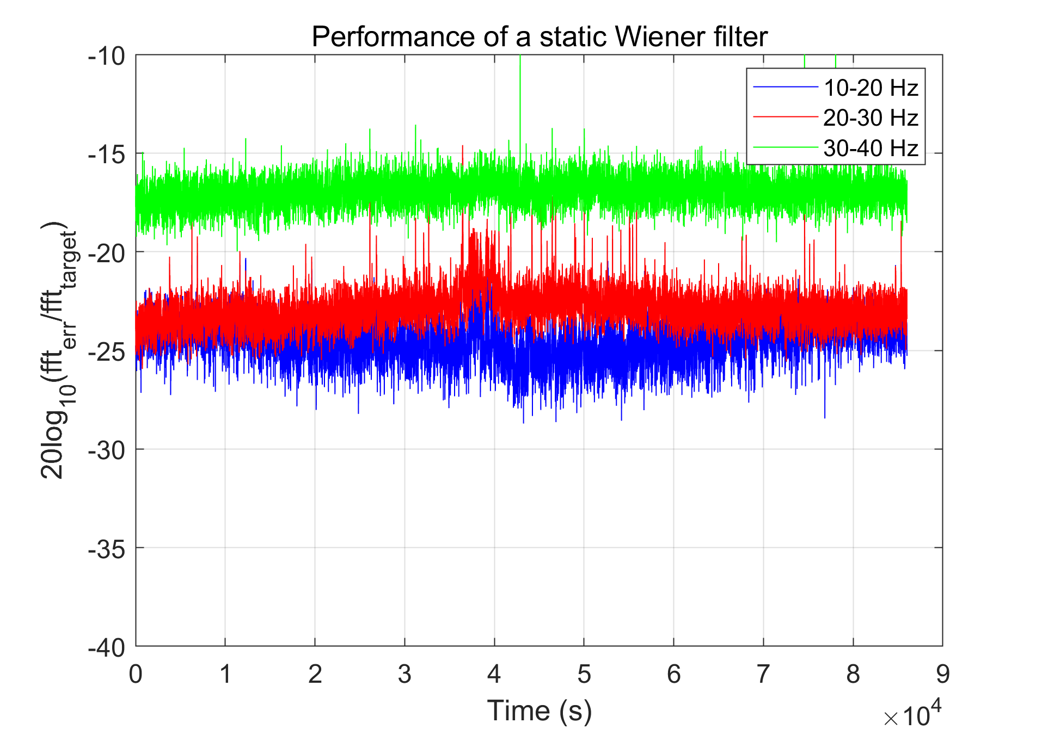
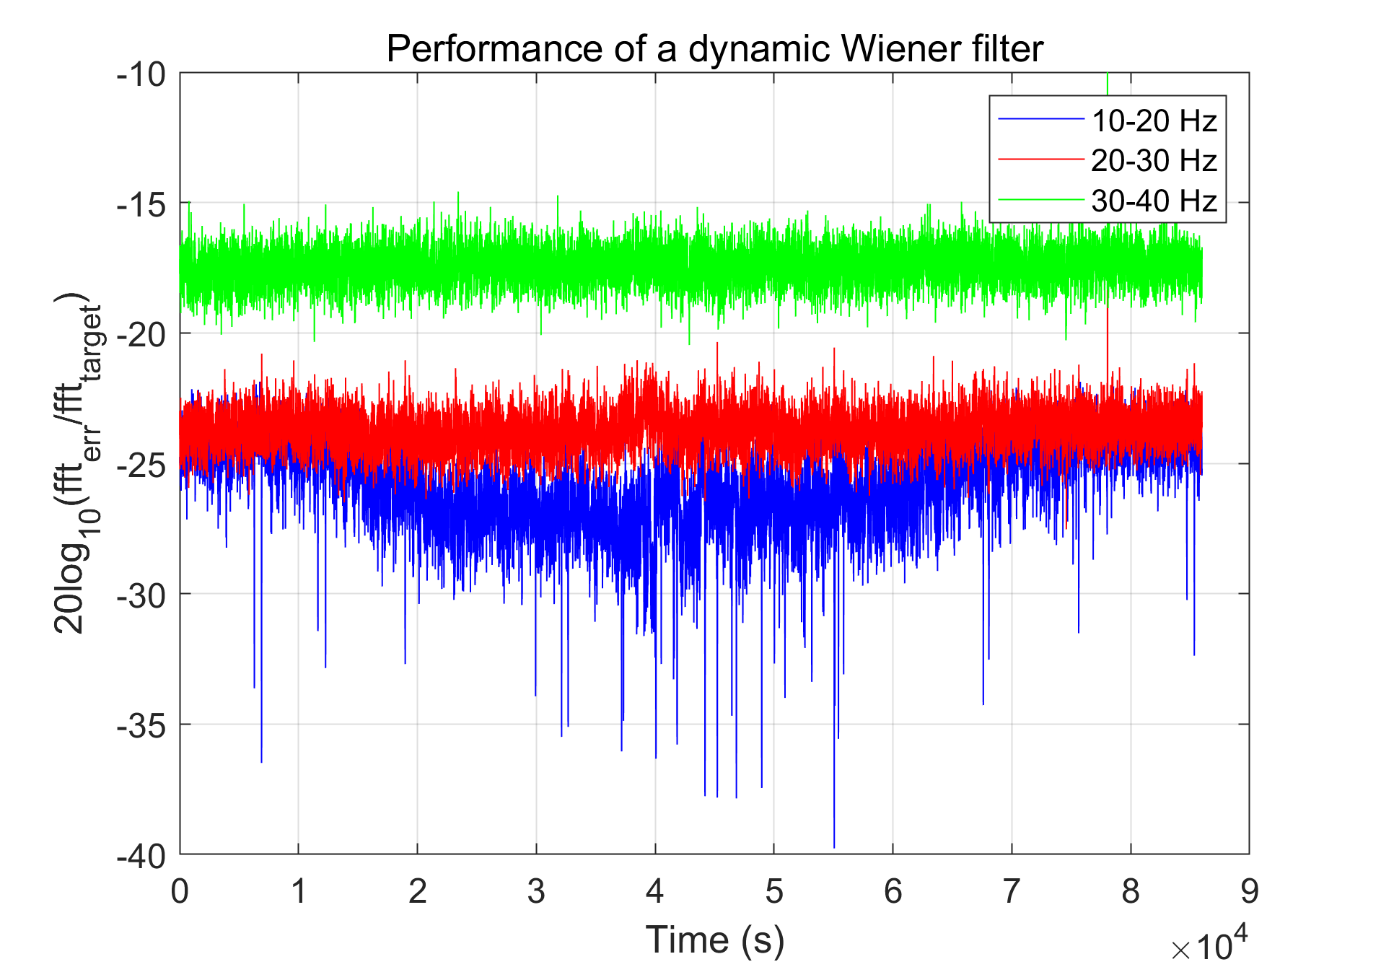
Wiener filter – Static vs Dynamic (CEB_SEIS_V as target)
About 10 dB better performance for transients
10-20 Hz 25-27 dB
20-30 Hz 20-25 dB
30-40 Hz 16-18 dB
About 2 dB better performance for transients
Similar performance in 30-40 Hz band

Slide 24
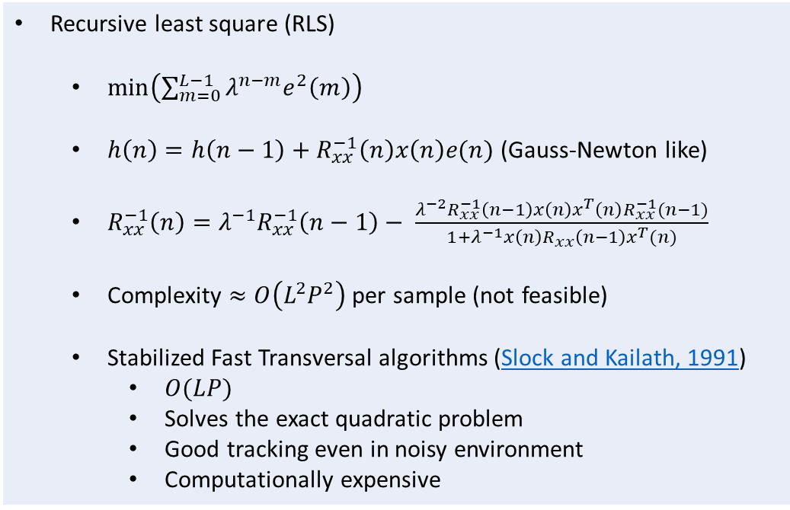
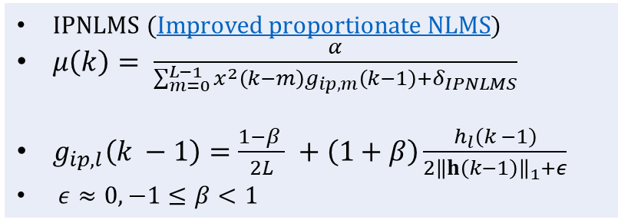
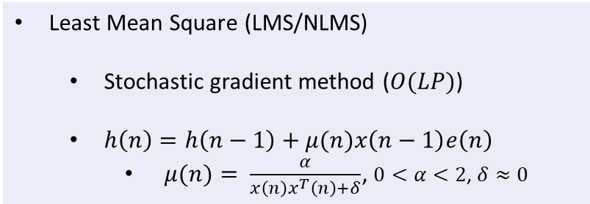
Adaptive filters
Two broad classes of algorithms exist for solving the Wiener problem:
Least Mean Square (LMS/NLMS)
Stochastic gradient method ($O(LP)$)
$h\left(n\right)=h\left(n−1\right)+μ(n)x\left(n−1\right)e\left(n\right)$
$μ(n)= \frac{α}{x\left(n\right)x^{T}\left(n\right)+δ}$, $0<α<2$, $δ≈0$
Recursive least square (RLS)
$\min\left(\sum_{m=0}^{L−1}{λ^{n−m}e^{2}\left(m\right)}\right)$
$h\left(n\right)=h\left(n−1\right)+R_{xx}^{−1}\left(n\right)x\left(n\right)e(n)$ (Gauss-Newton like)
$R_{xx}^{−1}\left(n\right)=λ^{−1}R_{xx}^{−1}\left(n−1\right)− \frac{λ^{−2}R_{xx}^{−1}\left(n−1\right)x\left(n\right)x^{T}\left(n\right)R_{xx}^{−1}(n−1)}{1+λ^{−1}x\left(n\right)R_{xx}\left(n−1\right)x^{T}(n)}$
Complexity $≈O\left(L^{2}P^{2}\right)$ per sample (not feasible)
Stabilized Fast Transversal algorithms (Slock and Kailath, 1991)
$O(LP)$
Solves the exact quadratic problem
Good tracking even in noisy environment
Computationally expensive
IPNLMS (Improved proportionate NLMS)
$μ\left(k\right)= \frac{α}{\sum_{m=0}^{L−1}{x^{2}\left(k−m\right)g_{ip,m}\left(k−1\right)+δ_{IPNLMS}}}$
$g_{ip,l}\left(k −1\right)=\frac{1−β }{2L} +\left(1+β\right)\frac{h_{l}\left(k −1\right)}{2{\left\|h\left(k−1\right)\right\|}_{1}+ε}$
$ε≈0, −1≤β<1$

Slide 25
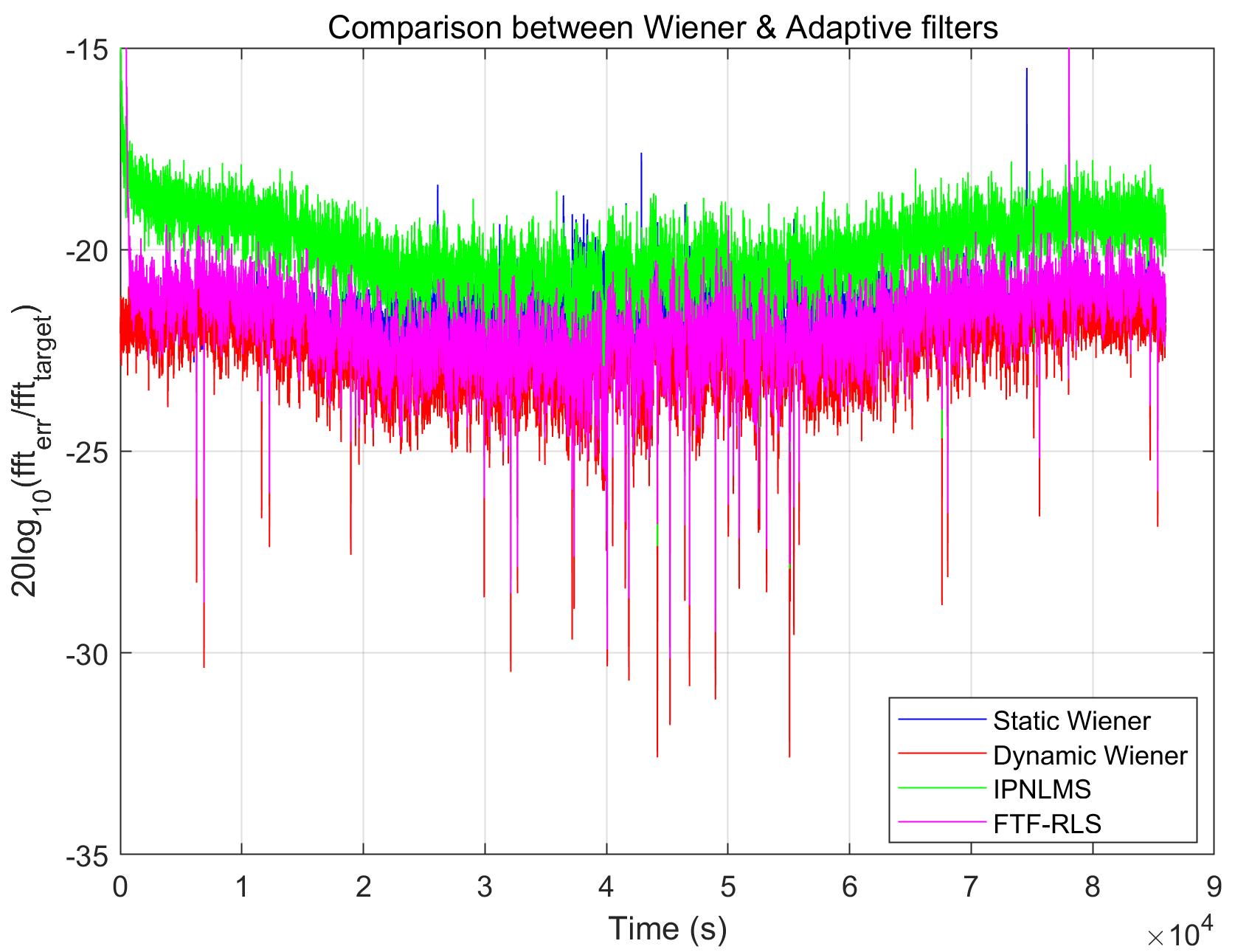
Wiener vs Adaptive filters (CEB_SEIS_V as target)
IPNLMS performs about 4 dB worse than Wiener/Dynamic-Wiener during quiet times
During short-burst transients IPNLMS does better than static Wiener filter but worse than Dynamic Wiener or FTF-RLS
Performance of FTF RLS comparable to the dynamic Wiener filter

Slide 26
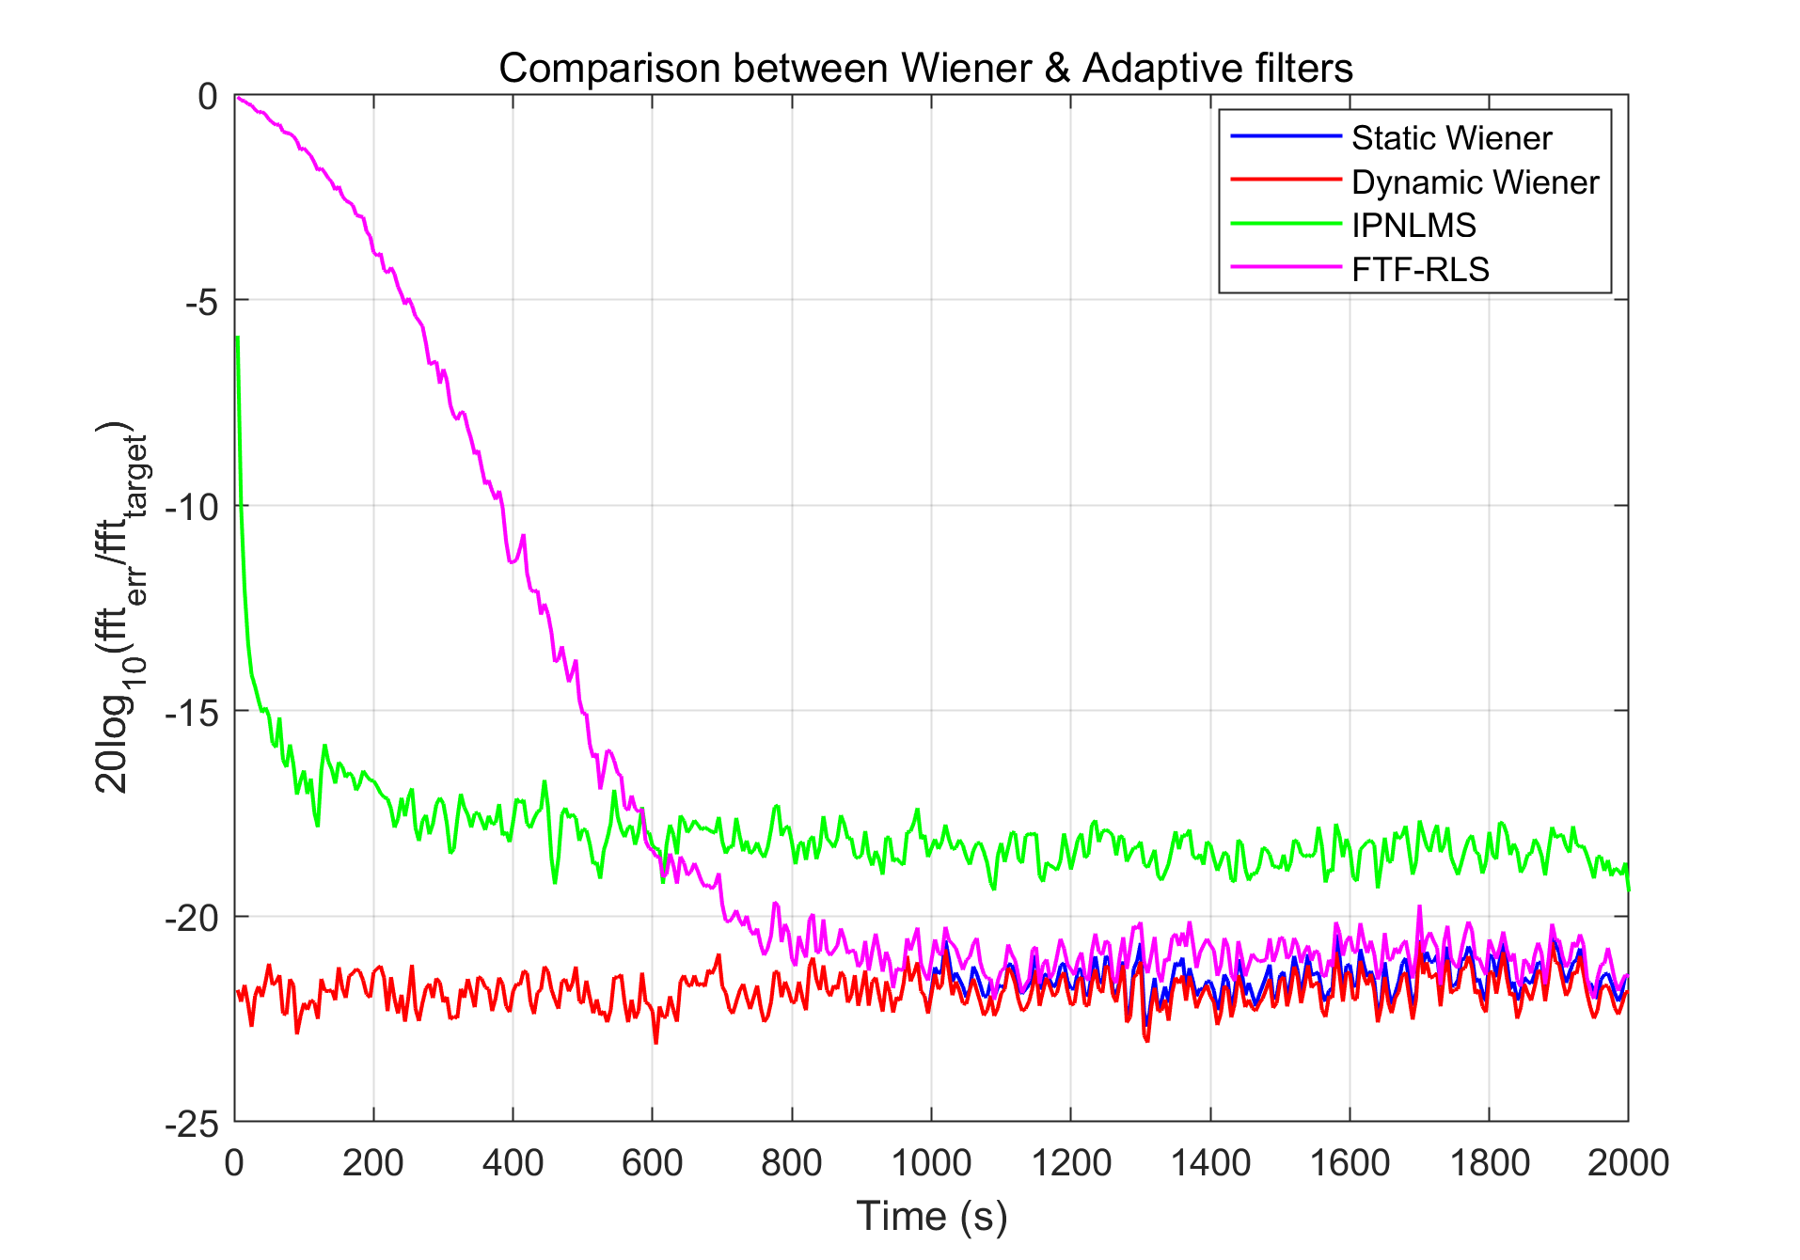
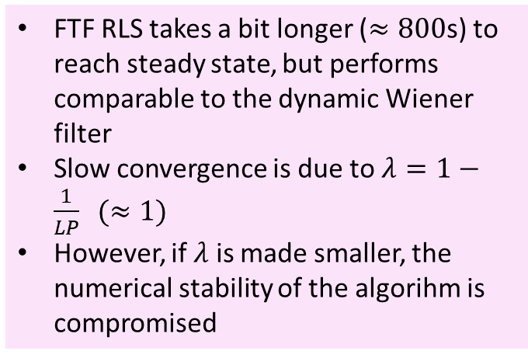
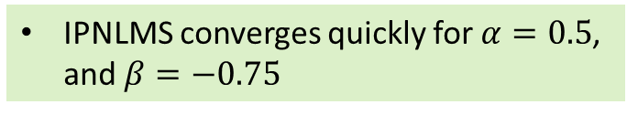
Wiener vs Adaptive filters at the onset (CEB_SEIS_V as target)
IPNLMS converges quickly for $α=0.5$, and $β=−0.75$
FTF RLS takes a bit longer ($≈800$s) to reach steady state, but performs comparable to the dynamic Wiener filter
Slow convergence is due to $λ=1−\frac{1}{LP} (≈1)$
However, if $λ$ is made smaller, the numerical stability of the algorihm is compromised

Slide 27

Wiener vs Adaptive filters during transients (CEB_SEIS_V as target)
FTF RLS performs within a dB of the dynamic Wiener filter
During quiet-times its performance is between the static and the dynamic Wiener filters
Performance can be improved by modifying the rescue procedure
Soft-constrained initialization is in play
Decorrelate inputs to stabilize the condition number of the forward and backward predictor matrices

Slide 28

Wiener vs Adaptive filters (CEB_SEIS_N as target)
Maximum gain of about 10 dB during quiet times (was 25 dB for V-target)
Performance worse by about 2-3 dB during noisy-times
Static Wiener filter performance worse for transients
Unfavorable wave-types
IPNLMS performance comparable to or better than FTF-RLS for transients
Performance worse by 3-4 dBs during quiet-times
Performance of FTF RLS comparable to dynamic Wiener filter performance

Slide 29

Wiener vs Adaptive filters at the onset (CEB_SEIS_V as target)
IPNLMS convergence times is the same as that of FTF-RLS
Performance worse by 3 dBs for quiet times
FTF RLS comparable to that of dynamic Wiener filter
Performance close to static Wiener filter

Slide 30


Wiener vs Adaptive filters during transients (CEB_SEIS_N as target)
During noisy times, performance of all algorithms are comparable except for the static Wiener filter, which adds noise to the data-stream
FTF RLS performance is close to dynamic Wiener filter and outperforms IPNLMS marginally ($1−2$ dB)
Overall cancellation of the horizontal channel using vertical channels as input is a challenging problem and is a scenario similar to NN-cancellation

Slide 31
Conclusions
55 vertical component 4.5 Hz geophones in the CEB, 28 in the NEB and 30 in the WEB were installed
Data digitization at 500 sps performed within the sensors and data readout was integrated with the Virgo DAQ system (time synchronized)
Sensor locations - optimization studies based on seismic wavefield characteristics and simulated NN were performed
An online NNC implementation has been done based on the static Wiener filter case (https://git.ligo.org/virgo/virgoapp/NNCfilter/-/tree/NNCTest01)
Adaptive filter options were explored: LMS (different classes) and RLS (FTF, FLA)
FTF-RLS were found to be robust, and were tested offline
Performance could be enhanced by designing better rescue algorithms
A challenging problem of subtracting the horizontal seismic noise channel by using the vertical channel was considered
Gain of about 10 dB during quiet times and about 7-8 dB during noisy times could be achieved
Performance worse by about 15 dB compared to the scenario when the vertical channel was used as target

Slide 32

Questions?

